Slide 1

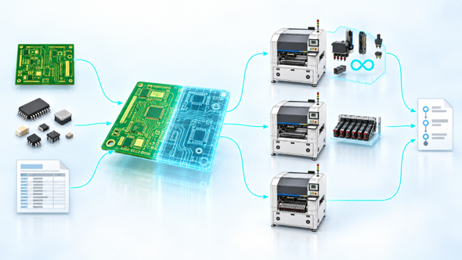
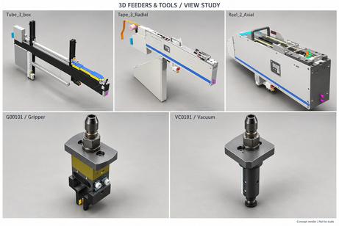
DIATwin MachinePilot Training Kit
Course Guide and Basic Operations
What Is MachinePilot?
Page 1 of 14
Prepare products, configure machine accessories, and review process simulations on your computer.
Parts
Prepare geometry and accessory relationships
Product
Create a board, panel, or carrier
Recipe
Configure the machine, then plan and simulate processing
What do you start with?
What do you review at the end?
Page 1
Notes:
{"使用者母版頁": 1, "原教材頁": 1, "整合單元來源頁": null, "每頁建議分鐘": "3–5", "來源界線": "", "目標": "第一頁兼封面，以一張情境圖說明本課用途、對象與預期成果。", "未補齊證據": [], "截圖處理": "保留真實介面；來源有文字帶者改用既有無文字帶出版截圖；單元局部圖沿用原圖裁切與來源。"}

Slide 2
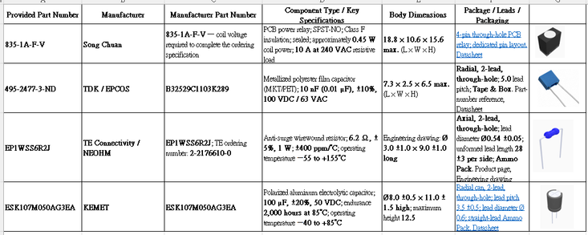
DIATwin MachinePilot Training Kit
Course Guide and Basic Operations
Starting Data and Checks
Page 2 of 14
Prepare the product data, BOM, and component database before starting.
Check the task data
Compare the Gerber data and work instructions or component list. Check components, part numbers, reference designators, and board locations.
What the template provides
Check the board structure, workpart properties, fiducials, and positioning method. Identify existing data and missing information.
Confirm readiness
Component Part Numbers
Check component-to-accessory relationships and machine data. Select the same saved product when creating the recipe.
Reference
Part Number
Description
C52
495-2473-3-ND
Metallized polyester film capacitor; 10 nF, ±10%, 100 V DC / 63 V AC
Scope of the examples
C172
ESK107M050AG3EA
Polarized aluminum electrolytic capacitor; 100 μF, ±20%, 50 V DC; 2,000 h at 85°C; −40 to 85°C
The examples use Demo_Single_Board, Demo_Panel_Board, or Demo_Carrier_Board.
D01
EP1WSS6R2J
Surge-resistant wirewound resistor; 6.2 Ω, ±5%, 1 W; ±400 ppm/°C; −55 to 155°C
RY1
835-1A-F-V
PCB power relay; SPST-NO, Class F insulation, sealed; coil approximately 0.45 W; 240 V AC / 10 A resistive load
Page 2
Component List
Notes:
{"使用者母版頁": 2, "原教材頁": 2, "整合單元來源頁": null, "每頁建議分鐘": "3–5", "來源界線": "", "目標": "一張圖帶出BOM、元件、裝載與機台條件的困難。", "未補齊證據": [], "截圖處理": "保留真實介面；來源有文字帶者改用既有無文字帶出版截圖；單元局部圖沿用原圖裁切與來源。"}

Slide 3
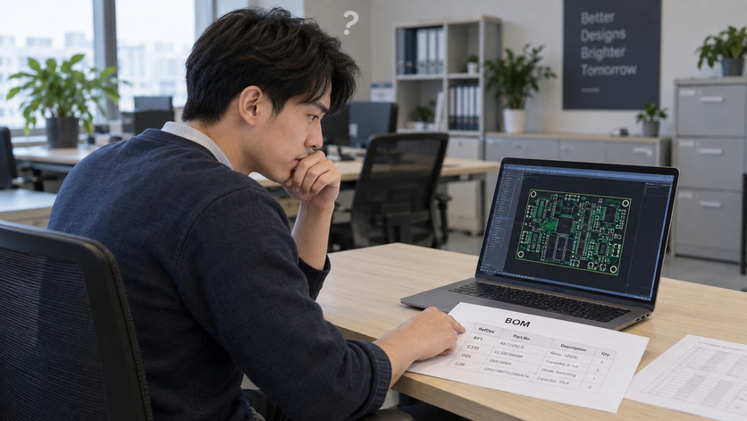
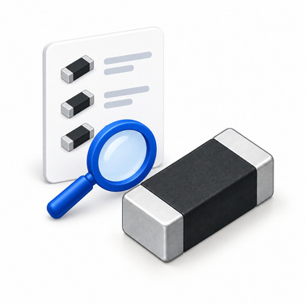
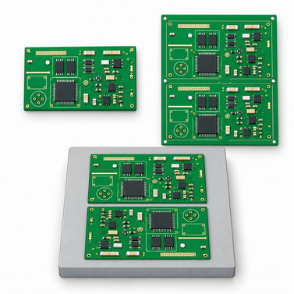
DIATwin MachinePilot Training Kit
Course Guide and Basic Operations
MachinePilot Training Kit
Page 3 of 14
Step 1 of 2
The Challenge
The Solution
1
Course Story
2
Basics
Progress from a single board and a new part number to a panel and two products on a carrier.
Expected Outcome
Choose suitable product and setup methods.
Explain the simulation results.
Page 3
Notes:
{"使用者母版頁": 3, "原教材頁": 3, "整合單元來源頁": null, "每頁建議分鐘": "3–5", "來源界線": "", "目標": "用解法圖說明元件→產品→Recipe、配置與模擬的關係，吸收Workflow概念。", "未補齊證據": ["G-CHECK"], "截圖處理": "保留真實介面；來源有文字帶者改用既有無文字帶出版截圖；單元局部圖沿用原圖裁切與來源。"}

Slide 4
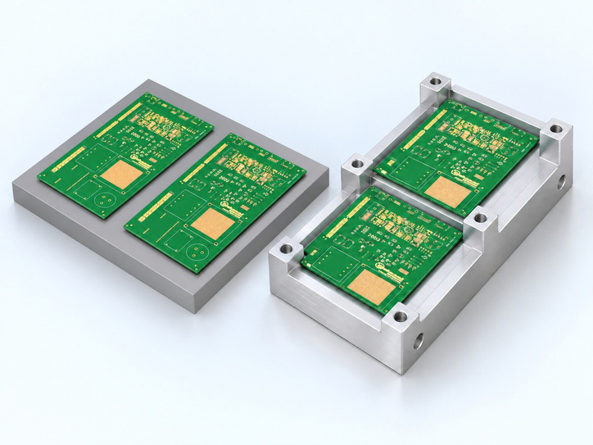
DIATwin MachinePilot Training Kit
Course Guide and Basic Operations
Four Scenarios and Today's Learning Goals
Page 4 of 14
Step 1 of 2
Scenario 1: Single Board
3D Concept Illustration
Course Story
Use four prepared components to complete product creation and automatic
recipe planning.
1
Scenario 2: New Part + Front Feed
2
Basics
Reuse existing geometry for a new part number, update annotations, and
restrict feeder placement.
Scenarios 3 and 4: Panel and Carrier
Compare panel processing modes, create carrier products, and plan
recipes independently.
Page 4
Notes:
{"使用者母版頁": 4, "原教材頁": 4, "整合單元來源頁": null, "每頁建議分鐘": "3–5", "來源界線": "", "目標": "同頁呈現四情境路線與辨識問題、選擇方法、完成並驗證成果的目標。", "未補齊證據": [], "截圖處理": "保留真實介面；來源有文字帶者改用既有無文字帶出版截圖；單元局部圖沿用原圖裁切與來源。"}

Slide 5
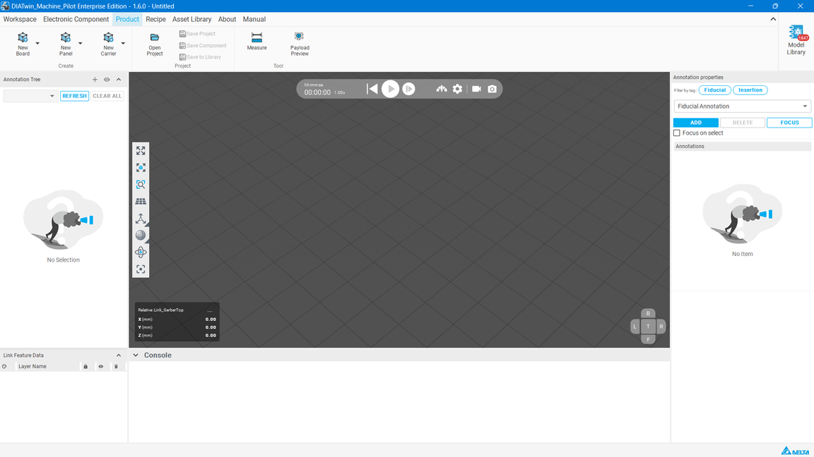
DIATwin MachinePilot Training Kit
Course Guide and Basic Operations
Explore the Workspace
Menu
Page 5 of 14
Menus: Workspace, Electronic Component, Product, Recipe, Database Management,
About, Manual. Each opens its own tools.
Step 2 of 2
1
Course Story
Properties and 3D View
Object Tree
Locate the product, board, geometry link, and annotations. Select the correct
object before editing.
Read the selected object's data and check its geometry and position.
2
Basics
Messages and Results
Page 5
Check save, setup, and simulation messages.
Notes:
{"使用者母版頁": 5, "原教材頁": 5, "整合單元來源頁": null, "每頁建議分鐘": "3–5", "來源界線": "", "目標": "用介面全貌圖指認物件樹、屬性、3D視窗與訊息區，示範各區用途。", "未補齊證據": ["G-UI"], "截圖處理": "保留真實介面；來源有文字帶者改用既有無文字帶出版截圖；單元局部圖沿用原圖裁切與來源。"}

Slide 6
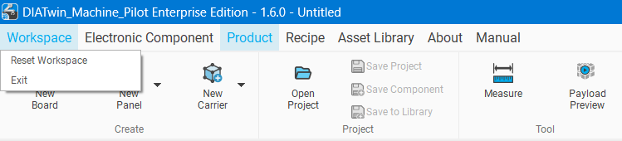
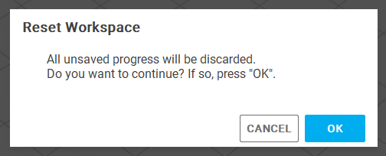
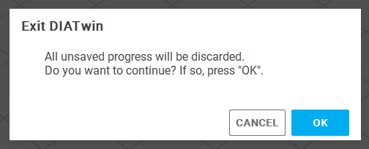
DIATwin MachinePilot Training Kit
Course Guide and Basic Operations
Explore the Workspace
Page 6 of 14
Menu
Step 2 of 2
Workspace
  Reset Workspace: Clear the current project.
  Exit: Close the application.
1
Course Story
2
Basics
Page 6
Notes:
{"使用者母版頁": 5, "原教材頁": 5, "整合單元來源頁": null, "每頁建議分鐘": "3–5", "來源界線": "", "目標": "用介面全貌圖指認物件樹、屬性、3D視窗與訊息區，示範各區用途。", "未補齊證據": ["G-UI"], "截圖處理": "保留真實介面；來源有文字帶者改用既有無文字帶出版截圖；單元局部圖沿用原圖裁切與來源。"}

Slide 7
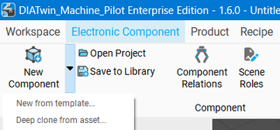
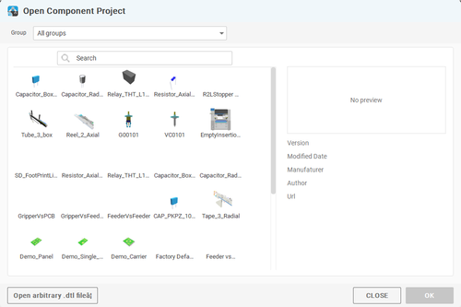
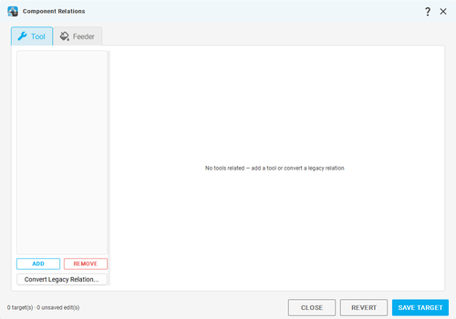
DIATwin MachinePilot Training Kit
Course Guide and Basic Operations
Explore the Workspace
Page 7 of 14
Menu
Step 2 of 2
Electronic Component
  New Component: Create from geometry (later).
    New from Template: Create from a template (later).
    Deep Clone from Asset: Copy a component and its related assets. Set the database group and part number. Used in this course.
  Open Project: Choose a database group and component.
  Save to Library: Save the component and settings to its group.
  Component Relations: Set tool/feeder links (advanced).
  Scene Roles: Set simulation roles (advanced).
1
Course Story
2
Basics
Page 7
Notes:
{"使用者母版頁": 5, "原教材頁": 5, "整合單元來源頁": null, "每頁建議分鐘": "3–5", "來源界線": "", "目標": "用介面全貌圖指認物件樹、屬性、3D視窗與訊息區，示範各區用途。", "未補齊證據": ["G-UI"], "截圖處理": "保留真實介面；來源有文字帶者改用既有無文字帶出版截圖；單元局部圖沿用原圖裁切與來源。"}

Slide 8
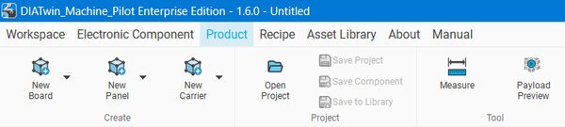
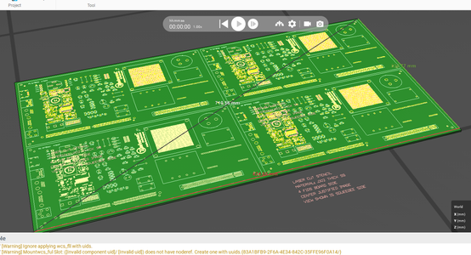
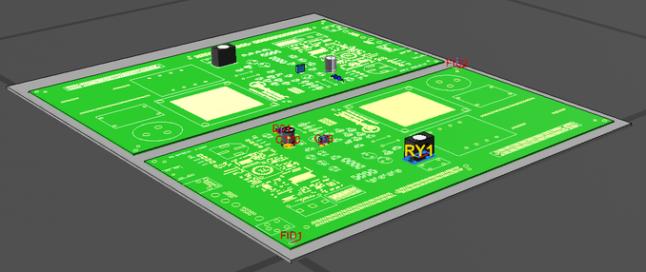
DIATwin MachinePilot Training Kit
Course Guide and Basic Operations
Explore the Workspace
Page 8 of 14
Menu
Step 2 of 2
Product
  New Board: Create a single board.
  New Panel: Panel; cross-board or whole-panel planning.
  New Carrier: Carrier; cross-board planning only.
  Open Project: Select a product.
  Save to Library: Save to the database group.
  Measure: Check X, Y, Z distances.
    Origin to feature: Click the floor, then the feature.
    Feature to feature: Click the start, then the end feature.
  Payload Preview: Load 3D models; check footprint alignment.
1
Course Story
2
Basics
Page 8
Notes:
{"使用者母版頁": 5, "原教材頁": 5, "整合單元來源頁": null, "每頁建議分鐘": "3–5", "來源界線": "", "目標": "用介面全貌圖指認物件樹、屬性、3D視窗與訊息區，示範各區用途。", "未補齊證據": ["G-UI"], "截圖處理": "保留真實介面；來源有文字帶者改用既有無文字帶出版截圖；單元局部圖沿用原圖裁切與來源。"}

Slide 9
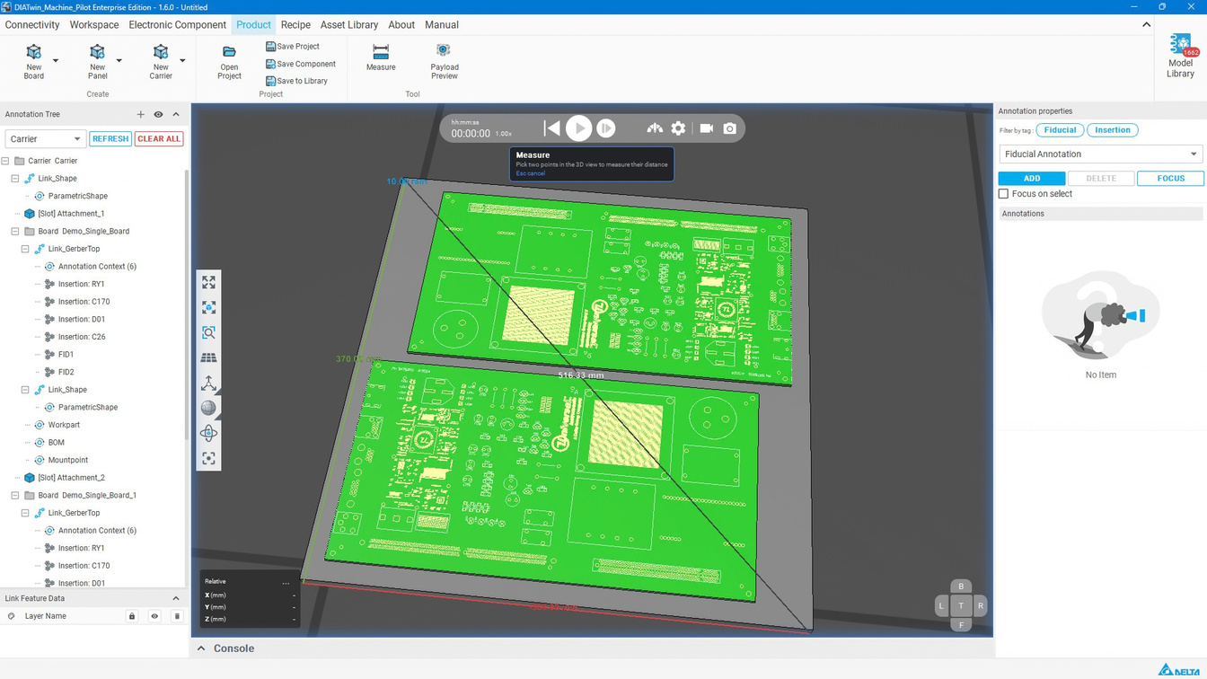
DIATwin MachinePilot Training Kit
Course Guide and Basic Operations
Object Selection and Parent–Child Hierarchy
Course Guide
Page 9 of 14
Menu
Step 2 of 2
Start at the correct level
Course Story
The board and its parent panel or carrier each have their own workpart and positioning data.
1
Match the tree to the view
2
Basics
Select a node and check its corresponding geometry in the 3D view before editing.
Identify what you are changing
Distinguish between editing a board, a geometry link, and the complete product.
Page 9
Notes:
{"使用者母版頁": 6, "原教材頁": 6, "整合單元來源頁": null, "每頁建議分鐘": "3–5", "來源界線": "", "目標": "串起樹節點與3D選取、父子層級及確認操作對象。", "未補齊證據": ["G-UI"], "截圖處理": "保留真實介面；來源有文字帶者改用既有無文字帶出版截圖；單元局部圖沿用原圖裁切與來源。"}

Slide 10
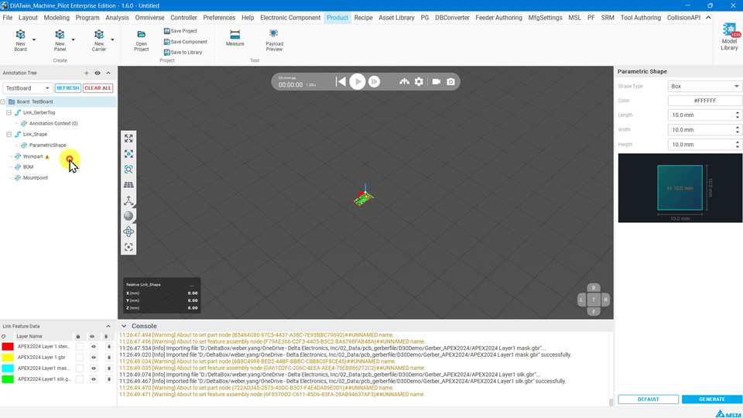
DIATwin MachinePilot Training Kit
Course Guide and Basic Operations
Focus and Inspect the 3D View
Course Guide
Page 10 of 14
Menu
Step 2 of 2
Focus on the work object
Course Story
Right-click the node and select Focus Viewport
/ Fit Board to view the board from above.
1
Rotate the view
2
Basics
Point at the object. Hold the mouse
wheel and move to rotate the
view.
Compare this with pointing at
the floor.
Pan the view
The viewpoint changes the view only. Move Board / Move
Geometry Link changes the object's position.
Page 10
Notes:
{"使用者母版頁": 7, "原教材頁": 7, "整合單元來源頁": null, "每頁建議分鐘": "3–5", "來源界線": "", "目標": "同頁示範聚焦、縮放、旋轉與適用的顯示操作，區分視角與模型移動。", "未補齊證據": ["G-UI"], "截圖處理": "保留真實介面；來源有文字帶者改用既有無文字帶出版截圖；單元局部圖沿用原圖裁切與來源。"}

Slide 11
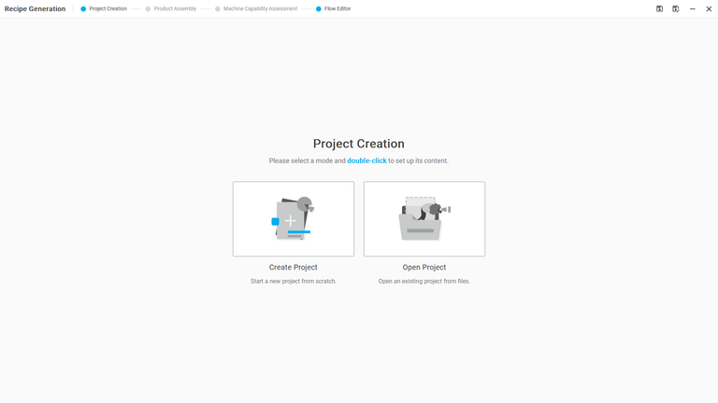
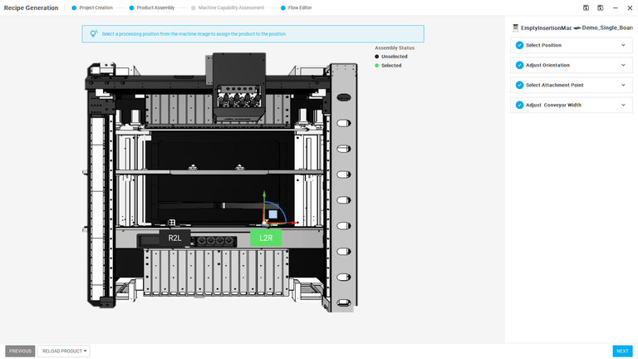
DIATwin MachinePilot Training Kit
Course Guide and Basic Operations
Explore the Workspace
Page 11 of 14
Menu
Step 2 of 2
Recipe
  Follow the workflow below:
    Project Creation
      Create Project
      Open Project
    Product Assembly
      Select Position: Set the product flow direction, from right to left or the reverse.
      Adjust Orientation: Rotate the product to match its actual working orientation.
      Select Attachment Point: Select a feature to connect the product to the machine. Hide the machine or conveyor as needed to improve visibility.
      Conveyor Width: Adjust the width as a reference for setting the physical conveyor.
1
Course Story
2
Basics
Page 11
Notes:
{"使用者母版頁": 5, "原教材頁": 5, "整合單元來源頁": null, "每頁建議分鐘": "3–5", "來源界線": "", "目標": "用介面全貌圖指認物件樹、屬性、3D視窗與訊息區，示範各區用途。", "未補齊證據": ["G-UI"], "截圖處理": "保留真實介面；來源有文字帶者改用既有無文字帶出版截圖；單元局部圖沿用原圖裁切與來源。"}

Slide 12
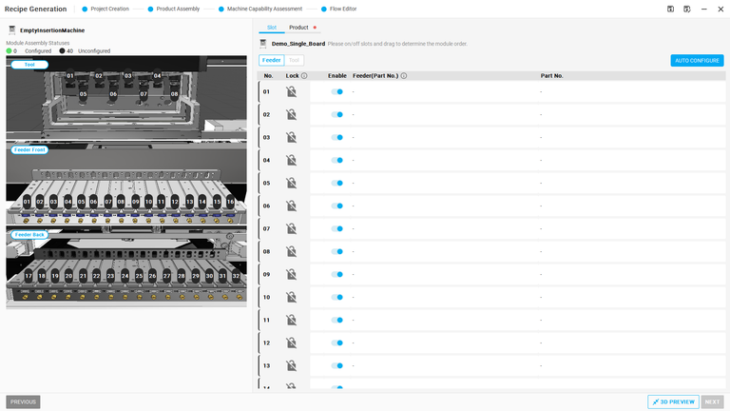
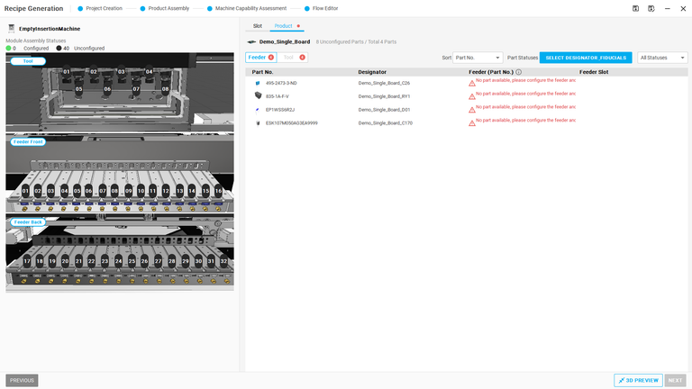
DIATwin MachinePilot Training Kit
Course Guide and Basic Operations
Explore the Workspace
Page 12 of 14
Menu
Step 2 of 2
Recipe
    Machine Capability Assessment
      Slot: Configure from the machine assembly perspective.
        Auto Configuration: Use the button at the upper right to plan according to locks and the current configuration.
        Lock: Preserve the current slot setting. An empty slot stays empty; an occupied slot retains its accessory. These constraints are passed to the algorithm.
        Enable: Control slot use in the current layout for machine readback.
      Product: Configure from the component perspective.
        Specify the feeder, tool, and installation position for each component.
1
Course Story
2
Basics
Page 12
Notes:
{"使用者母版頁": 5, "原教材頁": 5, "整合單元來源頁": null, "每頁建議分鐘": "3–5", "來源界線": "", "目標": "用介面全貌圖指認物件樹、屬性、3D視窗與訊息區，示範各區用途。", "未補齊證據": ["G-UI"], "截圖處理": "保留真實介面；來源有文字帶者改用既有無文字帶出版截圖；單元局部圖沿用原圖裁切與來源。"}

Slide 13
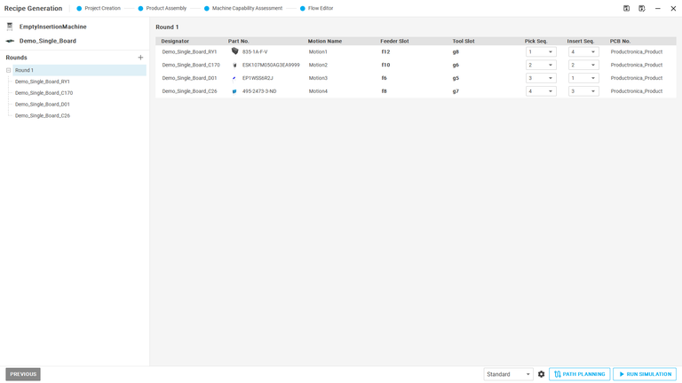
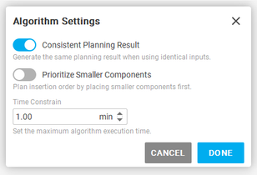
DIATwin MachinePilot Training Kit
Course Guide and Basic Operations
Explore the Workspace
Page 13 of 14
Menu
Step 2 of 2
Recipe
    Flow Editor: Adjust the generated process:
      Round
      Feeder slot
      Tool slot
      Pick sequence
      Insert sequence
    Algorithm Settings
        Consistent Planning Result: True by default; use consistent planning preferences.
        Prioritize Components: Prefer shorter parts first. Database integration is under verification.
        Time Constrain: Standard sets the planning time for a recipe result.
1
Course Story
2
Basics
Page 13
Notes:
{"使用者母版頁": 5, "原教材頁": 5, "整合單元來源頁": null, "每頁建議分鐘": "3–5", "來源界線": "", "目標": "用介面全貌圖指認物件樹、屬性、3D視窗與訊息區，示範各區用途。", "未補齊證據": ["G-UI"], "截圖處理": "保留真實介面；來源有文字帶者改用既有無文字帶出版截圖；單元局部圖沿用原圖裁切與來源。"}

Slide 14
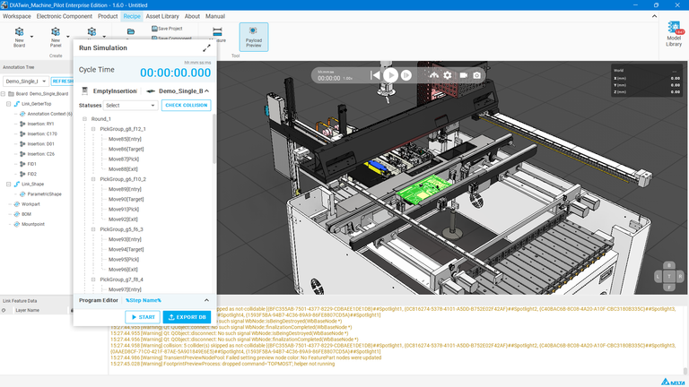
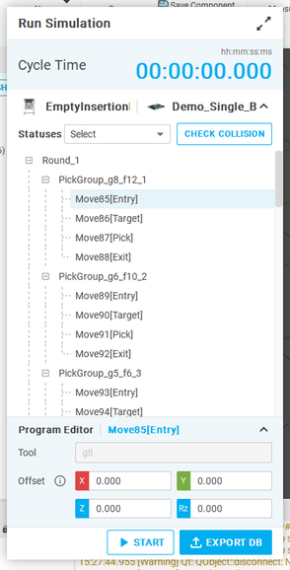
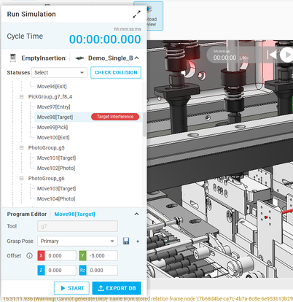
DIATwin MachinePilot Training Kit
Course Guide and Basic Operations
Explore the Workspace
Page 14 of 14
Menu
Step 2 of 2
Recipe
    Simulation
      Cycle Time: Available after simulation finishes.
      CHECK COLLISION: Check interference during downward Move actions.
      Move*** [Entry/Target/Place/Exit]: Algorithm-generated pick/place commands. Click a command to move the model immediately to that position.
      Grasp Pose: Select a different tool grasp pose (advanced).
      Offset: Adjust a point where interference occurs.
      START / RESET: Start or reset the simulation.
      EXPORT DB: Generate the D30 machine recipe.
1
Course Story
2
Basics
Page 14
Notes:
{"使用者母版頁": 5, "原教材頁": 5, "整合單元來源頁": null, "每頁建議分鐘": "3–5", "來源界線": "", "目標": "用介面全貌圖指認物件樹、屬性、3D視窗與訊息區，示範各區用途。", "未補齊證據": ["G-UI"], "截圖處理": "保留真實介面；來源有文字帶者改用既有無文字帶出版截圖；單元局部圖沿用原圖裁切與來源。"}

