Slide 1

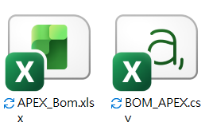
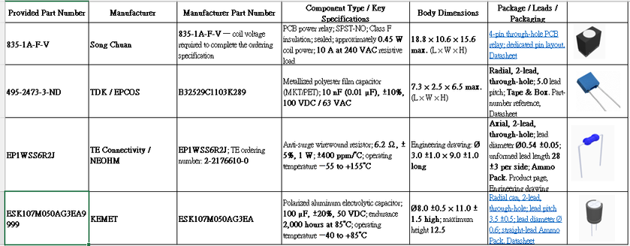
DIATwin MachinePilot Training Kit
Scenario 1 | Fully Automatic Single Board
Scenario 1: Task and Preparation
Page 1 of 20
Step 1 of 5
Source Materials
Prepare
Prepare Demo_Single_Board, APEX Gerber,
BOM_APEX.csv, and APEX_Bom.xlsx.
1
2
Parts
Demo Designators and Starting Data
Use RY1, C172, D01, and C52. Match BOM designators,
part numbers, and geometry before annotation.
3
Product
4
Recipe
Save the product; auto-configure the recipe. Check collisions, simulate, and record cycle time.
5
Results
Page 15
Notes:
{"使用者母版頁": 9, "原教材頁": 9, "整合單元來源頁": null, "每頁建議分鐘": "3–5", "來源界線": "", "目標": "一頁交代任務與Demo_Single_Board、四料BOM／零件表、Gerber、機台及配件，區分已備妥與待完成項目。", "未補齊證據": ["QS01-GAP-01"], "截圖處理": "保留真實介面；來源有文字帶者改用既有無文字帶出版截圖；單元局部圖沿用原圖裁切與來源。"}

Slide 2
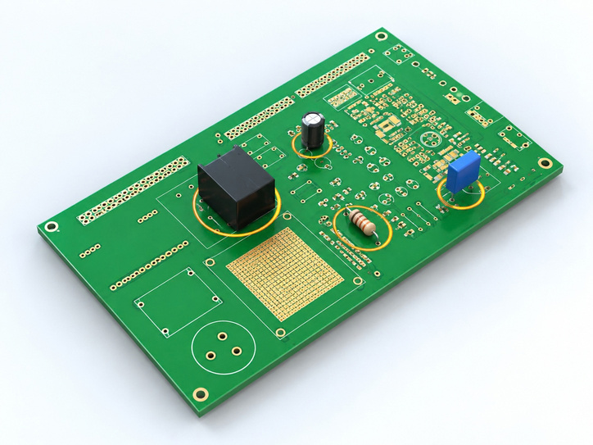
DIATwin MachinePilot Training Kit
Scenario 1 | Fully Automatic Single Board
Quick Start: From Annotation to Cycle Time
Page 2 of 20
Step 1 of 5
See the Full Workflow
3D Concept Illustration
Prepare
Annotate and save the product. Select the machine and product, then create
a recipe.
1
2
Parts
Follow the Sequence
After automatic configuration, check interference, run the simulation, and review the available cycle time.
3
Product
4
Recipe
Check Each Handoff
Identify the saved product, verified configuration, and simulation
results. Detailed operations follow in the next sections.
5
Results
Page 16
Notes:
{"使用者母版頁": 10, "原教材頁": 10, "整合單元來源頁": null, "每頁建議分鐘": "3–5", "來源界線": "", "目標": "以概念圖串起標註→保存產品→選擇機台與產品→全自動配置→確認干涉→模擬→取得並判讀CT，不呈現操作動作；概念動畫不取代實測證據。", "未補齊證據": ["QS01-GAP-01", "G-CHECK"], "截圖處理": "保留真實介面；來源有文字帶者改用既有無文字帶出版截圖；單元局部圖沿用原圖裁切與來源。"}

Slide 3
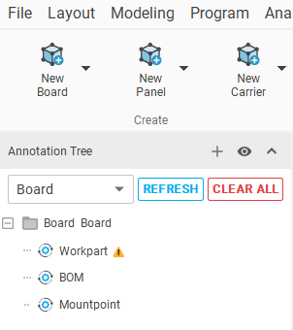
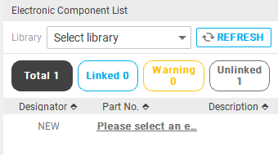

DIATwin MachinePilot Training Kit
Scenario 1 | Fully Automatic Single Board
Open Component Search
Page 3 of 20
Step 2 of 5
01
1
Prepare
New Single Board: check Board/BOM.
2
Parts
02
Select BOM to show the component list on the right.
3
Product
Fig. 1-02a New item and part number
03
Click + Add to insert a new item.
4
Recipe
Fig. 1-02b Add BOM item
04
Fig. 1-01 Product and BOM
5
Results
Click the new row's Part Number link to search components.
Page 17
Notes:
{"使用者母版頁": 11, "原教材頁": 11, "整合單元來源頁": 138, "每頁建議分鐘": "3–5", "來源界線": "", "目標": "維持一頁三段圖解：讀BOM／零件表→查候選→核對料號、照片、外形、尺寸與腳距；示範一個代表元件。", "未補齊證據": ["G-S1-PRODUCT"], "截圖處理": "保留真實介面；來源有文字帶者改用既有無文字帶出版截圖；單元局部圖沿用原圖裁切與來源。"}

Slide 4
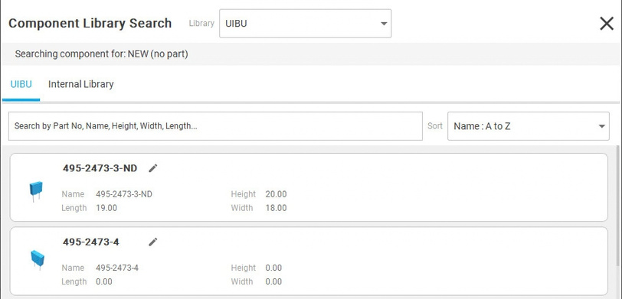
DIATwin MachinePilot Training Kit
Scenario 1 | Fully Automatic Single Board
Check Geometry and Part Number
Page 4 of 20
Step 2 of 5
01
1
Prepare
Shape, then part number.
02
2
Parts
Blue capacitor: 495-2473-3-ND.
3
Product
03
Same geometry and part number: link directly.
Change the original number: edit it.
Keep both numbers: use Deep Clone.
Different geometry: create a new component.
4
Recipe
5
Results
Fig. 1-03 Check geometry, part number, and name
Page 18
Notes:
{"使用者母版頁": 11, "原教材頁": 11, "整合單元來源頁": 139, "每頁建議分鐘": "3–5", "來源界線": "", "目標": "維持一頁三段圖解：讀BOM／零件表→查候選→核對料號、照片、外形、尺寸與腳距；示範一個代表元件。", "未補齊證據": ["G-S1-PRODUCT"], "截圖處理": "保留真實介面；來源有文字帶者改用既有無文字帶出版截圖；單元局部圖沿用原圖裁切與來源。"}

Slide 5
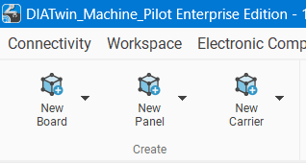
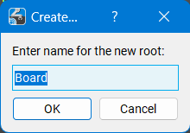
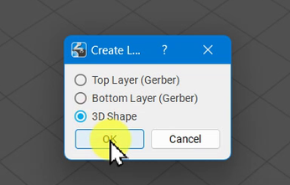
DIATwin MachinePilot Training Kit
Scenario 1 | Fully Automatic Single Board
Create the Board
Page 5 of 20
Designators: RY1, C172, D01, C52. Link each to its corresponding BOM part number.
Step 3 of 5
01
1
Prepare
Product → New Single Board. Name the root TestBoard; click OK.
2
Parts
02
Right-click the board root → Create Geometry Link. Select Top Layer (Gerber) and click OK. Repeat for the 3D shape.
3
Product
Fig. 1-04 Create the board
4
Recipe
5
Results
Fig. 1-05 Gerber and 3D links
Page 19
Notes:
{"使用者母版頁": 12, "原教材頁": 12, "整合單元來源頁": 147, "每頁建議分鐘": "3–5", "來源界線": "畫面沿用單板操作範例；本次加工位置為 RY1、C170、D01、C26。", "目標": "同頁串起板件結構識別、Gerber匯入與圖層核對，以結果圖確認本次來源。", "未補齊證據": ["G-S1-PRODUCT"], "截圖處理": "保留真實介面；來源有文字帶者改用既有無文字帶出版截圖；單元局部圖沿用原圖裁切與來源。"}

Slide 6
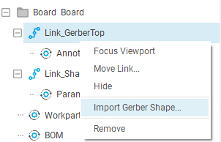
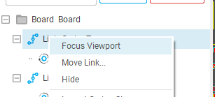
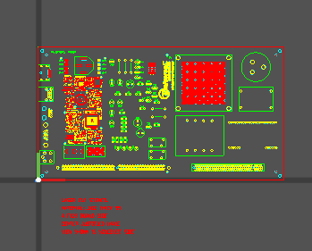
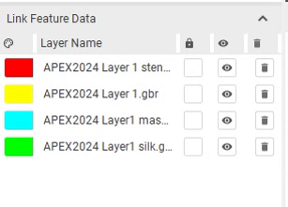
DIATwin MachinePilot Training Kit
Scenario 1 | Fully Automatic Single Board
Import Gerber
Page 6 of 20
Designators: RY1, C172, D01, C52. Link each to its corresponding BOM part number.
Step 3 of 5
01
1
Prepare
Gerber link → Import Gerber Shape. In APEX, Ctrl-select the four Gerber files; click Open. Check the imported layers.
2
Parts
3
Product
02
Right-click the board root → Focus View. Use the mouse wheel to adjust zoom.
4
Recipe
5
Results
Fig. 1-06 Import Gerber
Fig. 1-07 Focus on the board
Page 20
Notes:
{"使用者母版頁": 12, "原教材頁": 12, "整合單元來源頁": 148, "每頁建議分鐘": "3–5", "來源界線": "畫面沿用單板操作範例；本次加工位置為 RY1、C170、D01、C26。", "目標": "同頁串起板件結構識別、Gerber匯入與圖層核對，以結果圖確認本次來源。", "未補齊證據": ["G-S1-PRODUCT"], "截圖處理": "保留真實介面；來源有文字帶者改用既有無文字帶出版截圖；單元局部圖沿用原圖裁切與來源。"}

Slide 7
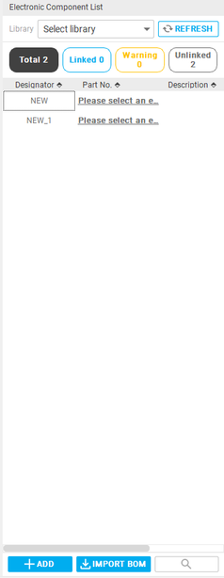
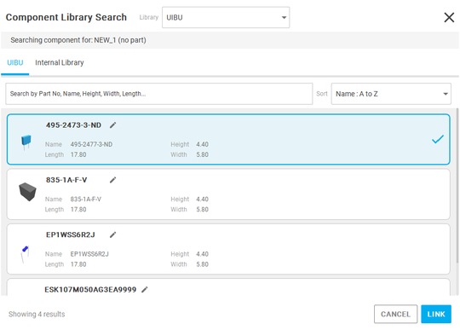
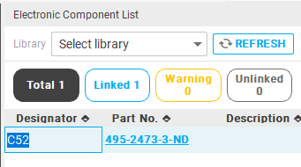
DIATwin MachinePilot Training Kit
Scenario 1 | Fully Automatic Single Board
Add BOM Items
Page 7 of 20
Designators: RY1, C172, D01, C52. Link each to its corresponding BOM part number.
Step 3 of 5
01
1
Prepare
BOM → Add. Click the new part-number link to search.
2
Parts
02
Link 495-2473-3-ND from the user database; check BOM.
3
Product
03
Fig. 1-08a Link the part number
4
Recipe
Double-click the new designator, enter C52, and press Enter. Repeat for the other training items.
5
Results
Fig. 1-08 BOM item
Fig. 1-09 Designator
Page 21
Notes:
{"使用者母版頁": 14, "原教材頁": 14, "整合單元來源頁": 149, "每頁建議分鐘": "3–5", "來源界線": "畫面沿用單板操作範例；本次加工位置為 RY1、C170、D01、C26。", "目標": "以對照表串起BOM建立、元件連結與RY1／C170／D01／C26位置辨識，示範一筆後核對全部。", "未補齊證據": ["G-S1-PRODUCT"], "截圖處理": "保留真實介面；來源有文字帶者改用既有無文字帶出版截圖；單元局部圖沿用原圖裁切與來源。"}

Slide 8
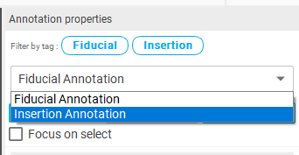
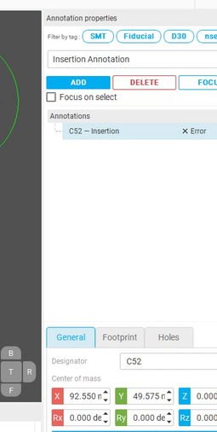

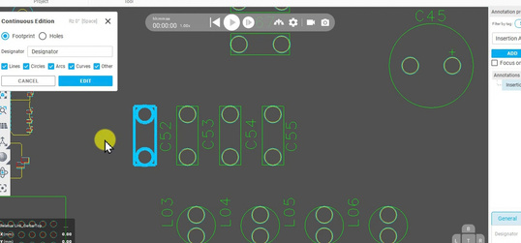
DIATwin MachinePilot Training Kit
Scenario 1 | Fully Automatic Single Board
Create Insertion Annotations
Page 8 of 20
Designators: RY1, C172, D01, C52. Link each to its corresponding BOM part number.
Step 3 of 5
01
1
Prepare
Add Insertion Annotation; right-click → Continuous Edit.
2
Parts
02
Select Footprint. Box-select the target 2D features; release and check the blue outline.
3
Product
03
Fig. 1-10 Insertion type
4
Recipe
Enter C52, matching the BOM. Click Edit; check Properties.
5
Results
Tip
Drag to select. Hold Ctrl and drag again to deselect.
Fig. 1-11 Box-select the footprint
Fig. 1-12 Annotation name
Page 22
Notes:
{"使用者母版頁": 15, "原教材頁": 15, "整合單元來源頁": 150, "每頁建議分鐘": "3–5", "來源界線": "畫面沿用單板操作範例；本次加工位置為 RY1、C170、D01、C26。", "目標": "同頁完成選取、Footprint、標註及方向檢查，典型選错修正放在同一動作後。", "未補齊證據": ["G-S1-PRODUCT"], "截圖處理": "保留真實介面；來源有文字帶者改用既有無文字帶出版截圖；單元局部圖沿用原圖裁切與來源。"}

Slide 9
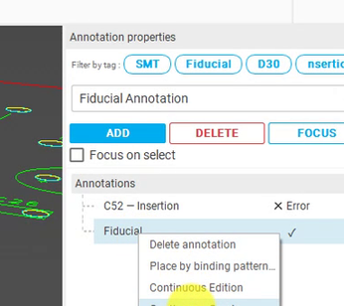
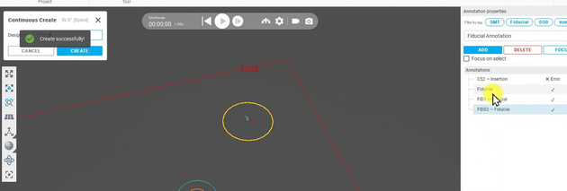
DIATwin MachinePilot Training Kit
Scenario 1 | Fully Automatic Single Board
Add Fiducials
Page 9 of 20
Designators: RY1, C172, D01, C52. Link each to its corresponding BOM part number.
Step 3 of 5
01
1
Prepare
Add Fiducial Annotation; right-click → Continuous Create.
2
Parts
02
Enter FID1; select its Gerber feature and click Create. Repeat for FID2. Click Cancel to finish.
3
Product
4
Recipe
Fig. 1-13 Add a fiducial item
5
Results
Fig. 1-14 Create two fiducials
Page 23
Notes:
{"使用者母版頁": 16, "原教材頁": 16, "整合單元來源頁": 152, "每頁建議分鐘": "3–5", "來源界線": "畫面沿用單板操作範例；本次加工位置為 RY1、C170、D01、C26。", "目標": "同頁看四位置結果與必要光學點，確認加工與定位資料完整。", "未補齊證據": ["G-S1-PRODUCT"], "截圖處理": "保留真實介面；來源有文字帶者改用既有無文字帶出版截圖；單元局部圖沿用原圖裁切與來源。"}

Slide 10
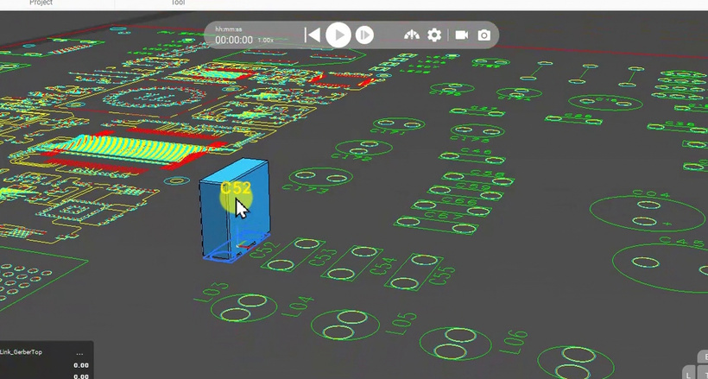
DIATwin MachinePilot Training Kit
Scenario 1 | Fully Automatic Single Board
Preview Components
Page 10 of 20
Designators: RY1, C172, D01, C52. Link each to its corresponding BOM part number.
Step 3 of 5
01
1
Prepare
Click Component Preview. After loading, check model-to-annotation alignment.
2
Parts
3
Product
4
Recipe
5
Results
Fig. 1-15 Preview components
Page 24
Notes:
{"使用者母版頁": 17, "原教材頁": 17, "整合單元來源頁": 151, "每頁建議分鐘": "3–5", "來源界線": "畫面沿用單板操作範例；本次加工位置為 RY1、C170、D01、C26。", "目標": "以產品可用為目標，整合Payload Preview、名稱／型錄／預覽保存及Recipe可查找結果。", "未補齊證據": ["G-S1-PRODUCT"], "截圖處理": "保留真實介面；來源有文字帶者改用既有無文字帶出版截圖；單元局部圖沿用原圖裁切與來源。"}

Slide 11
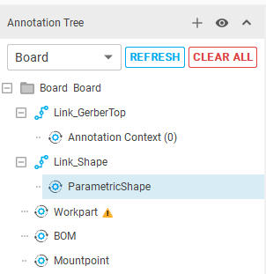
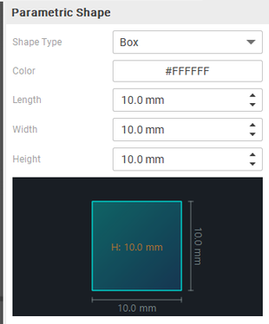
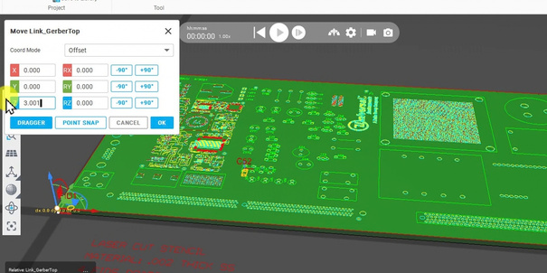
DIATwin MachinePilot Training Kit
Scenario 1 | Fully Automatic Single Board
Set the Board Geometry
Page 11 of 20
Designators: RY1, C172, D01, C52. Link each to its corresponding BOM part number.
Step 3 of 5
01
1
Prepare
Geometry Link → Parametric Shape: select color; measure diagonal corners. Set L/W/H = 304.8/165/3 mm; Generate.
2
Parts
3
Product
02
Exit Measure (click once and press Esc if needed). Right-click the top Gerber → Move. Set Z = 3.0 and click OK.
4
Recipe
Fig. 1-16 Board geometry
5
Results
Page 25
Fig. 1-17 Height
Notes:
{"使用者母版頁": 13, "原教材頁": 13, "整合單元來源頁": 153, "每頁建議分鐘": "3–5", "來源界線": "畫面沿用單板操作範例；本次加工位置為 RY1、C170、D01、C26。", "目標": "用同一板件核對外形、Workpart尺寸及定位／安裝參考，確認正確編輯層級。", "未補齊證據": ["G-S1-PRODUCT"], "截圖處理": "保留真實介面；來源有文字帶者改用既有無文字帶出版截圖；單元局部圖沿用原圖裁切與來源。"}

Slide 12
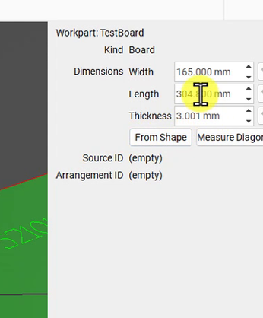
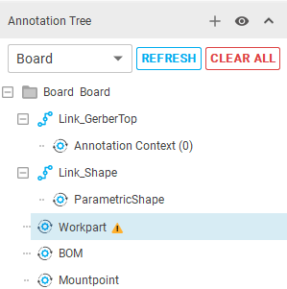
DIATwin MachinePilot Training Kit
Scenario 1 | Fully Automatic Single Board
Set Workpart Dimensions
Page 12 of 20
Designators: RY1, C172, D01, C52. Link each to its corresponding BOM part number.
Step 3 of 5
01
1
Prepare
Workpart → Measure Diagonal: W/L/T = 165/304.8/3 mm.
2
Parts
3
Product
4
Recipe
5
Results
Fig. 1-18 Set Workpart dimensions
Page 26
Notes:
{"使用者母版頁": 13, "原教材頁": 13, "整合單元來源頁": 154, "每頁建議分鐘": "3–5", "來源界線": "畫面沿用單板操作範例；本次加工位置為 RY1、C170、D01、C26。", "目標": "用同一板件核對外形、Workpart尺寸及定位／安裝參考，確認正確編輯層級。", "未補齊證據": ["G-S1-PRODUCT"], "截圖處理": "保留真實介面；來源有文字帶者改用既有無文字帶出版截圖；單元局部圖沿用原圖裁切與來源。"}

Slide 13
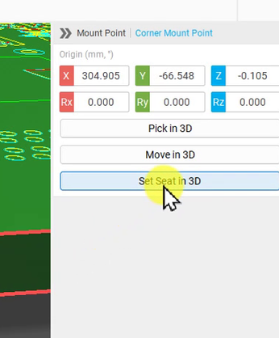
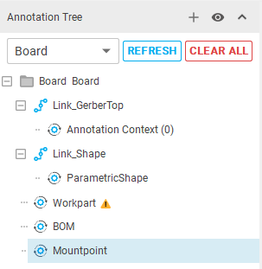
DIATwin MachinePilot Training Kit
Scenario 1 | Fully Automatic Single Board
Create the Board Mount Point
Page 13 of 20
Designators: RY1, C172, D01, C52. Link each to its corresponding BOM part number.
Step 3 of 5
01
1
Prepare
Mount Points → Create Mount Point. Inspect Corner Mount Point.
2
Parts
3
Product
4
Recipe
5
Results
Fig. 1-19 Default mount point
Page 27
Notes:
{"使用者母版頁": 13, "原教材頁": 13, "整合單元來源頁": 154, "每頁建議分鐘": "3–5", "來源界線": "畫面沿用單板操作範例；本次加工位置為 RY1、C170、D01、C26。", "目標": "用同一板件核對外形、Workpart尺寸及定位／安裝參考，確認正確編輯層級。", "未補齊證據": ["G-S1-PRODUCT"], "截圖處理": "保留真實介面；來源有文字帶者改用既有無文字帶出版截圖；單元局部圖沿用原圖裁切與來源。"}

Slide 14
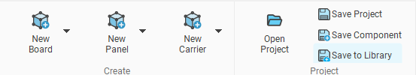
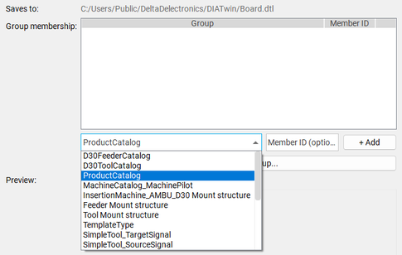
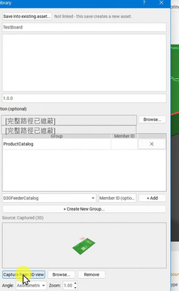
DIATwin MachinePilot Training Kit
Scenario 1 | Fully Automatic Single Board
Save the Product
Page 14 of 20
Use RY1, C172, D01, and C52. Match BOM designators, part numbers, and geometry before annotation.
Step 3 of 5
01
1
Prepare
Save: check name/version/path; add Product Catalog membership. Capture from 3D View; check preview, OK.
2
Parts
02
3
Product
Recipe → Create Project: find the saved product. Demo_Single_Board is the completed reference.
4
Recipe
5
Results
Fig. 1-20 Save command and asset settings
Page 28
Notes:
{"使用者母版頁": 17, "原教材頁": 17, "整合單元來源頁": 155, "每頁建議分鐘": "3–5", "來源界線": "畫面沿用單板操作範例；本次加工位置為 RY1、C170、D01、C26。", "目標": "以產品可用為目標，整合Payload Preview、名稱／型錄／預覽保存及Recipe可查找結果。", "未補齊證據": ["G-S1-PRODUCT"], "截圖處理": "保留真實介面；來源有文字帶者改用既有無文字帶出版截圖；單元局部圖沿用原圖裁切與來源。"}

Slide 15
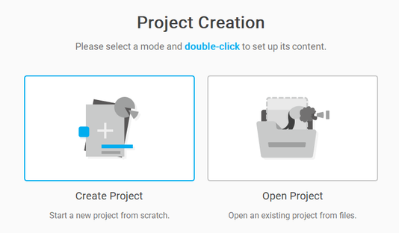
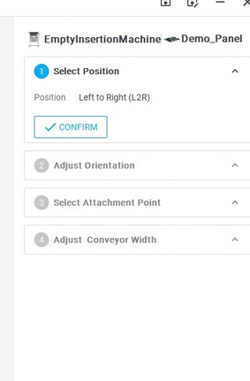
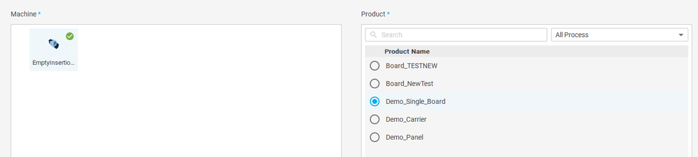
DIATwin MachinePilot Training Kit
Scenario 1 | Fully Automatic Single Board
Select the Machine and Single-Board Product
Page 15 of 20
Select your four-part single board. The panel illustrates the settings; use your product values.
Step 4 of 5
01
1
Prepare
Create Project: select the empty machine and saved four-part board; Next.
2
Parts
02
Check infeed, mount point, and conveyor width. Panel values are examples only.
3
Product
4
Recipe
5
Results
Fig. 1-21 Create a recipe
Fig. 1-22 Product mounting
Page 29
Notes:
{"使用者母版頁": 18, "原教材頁": 18, "整合單元來源頁": 186, "每頁建議分鐘": "3–5", "來源界線": "畫面沿用舊連板配方範例；本次選自己的四料單板，數量、尺寸與時間依實際結果。", "目標": "選機台與產品，核對方向、安裝參考及輸送寬度，同頁呈現組裝結果。", "未補齊證據": ["QS01-GAP-01"], "截圖處理": "保留真實介面；來源有文字帶者改用既有無文字帶出版截圖；單元局部圖沿用原圖裁切與來源。"}

Slide 16
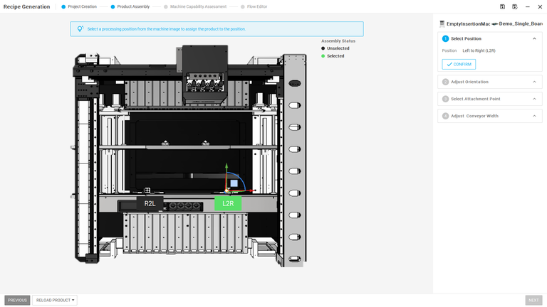
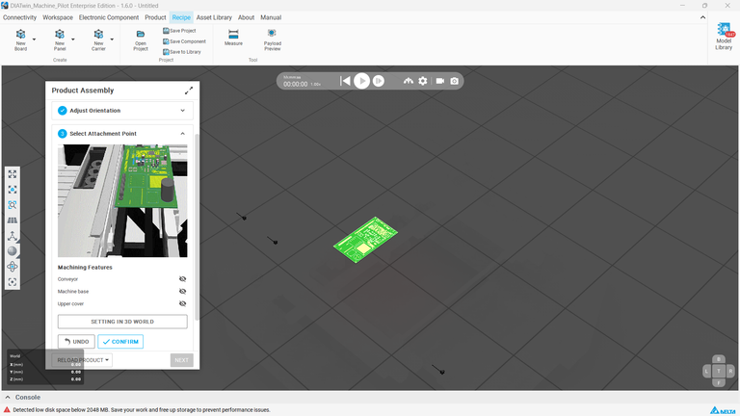
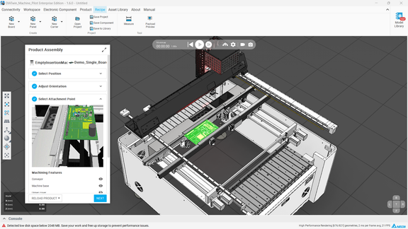
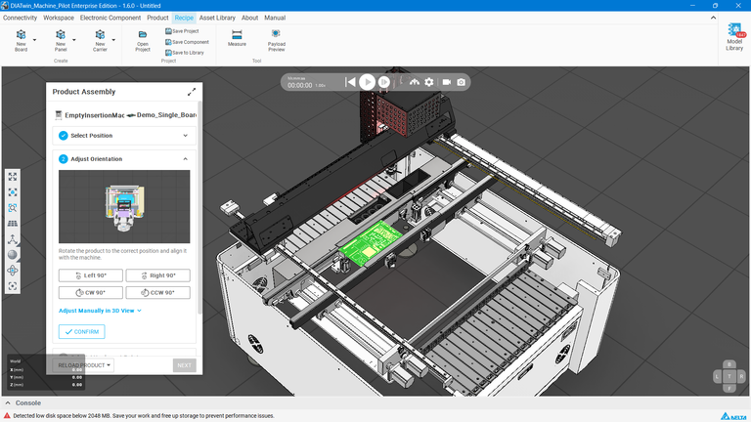
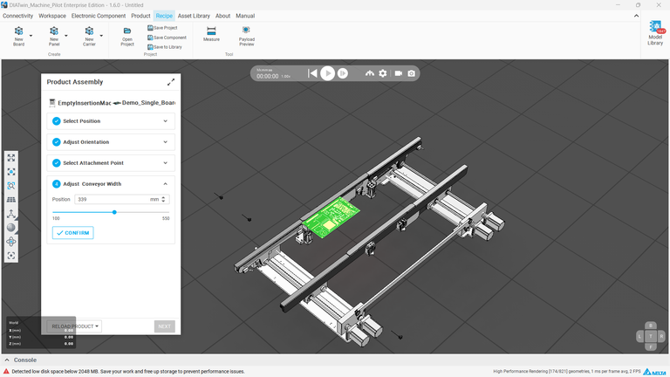
DIATwin MachinePilot Training Kit
Scenario 1 | Fully Automatic Single Board
Mount the Product in the Machine
Page 16 of 20
Step 4 of 5
1
Prepare
2
Parts
Fig. 1-22a Mounting position
Fig. 1-22c Attachment
3
Product
4
Recipe
5
Results
Page 30
Fig. 1-22b Orientation
Fig. 1-22d Conveyor width
Notes:
{"使用者母版頁": 18, "原教材頁": 18, "整合單元來源頁": 186, "每頁建議分鐘": "3–5", "來源界線": "畫面沿用舊連板配方範例；本次選自己的四料單板，數量、尺寸與時間依實際結果。", "目標": "選機台與產品，核對方向、安裝參考及輸送寬度，同頁呈現組裝結果。", "未補齊證據": ["QS01-GAP-01"], "截圖處理": "保留真實介面；來源有文字帶者改用既有無文字帶出版截圖；單元局部圖沿用原圖裁切與來源。"}

Slide 17
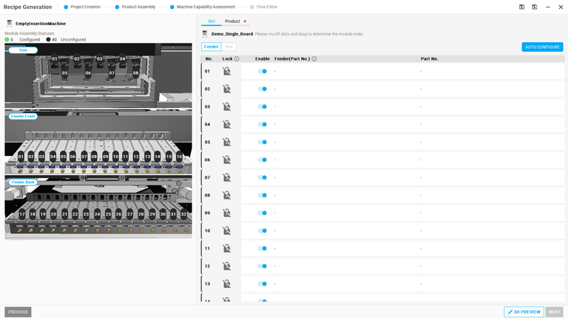

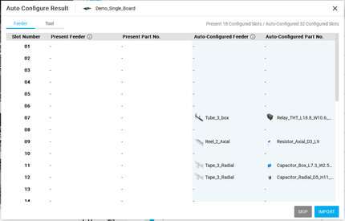
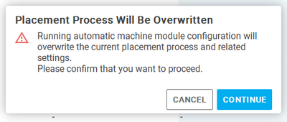
DIATwin MachinePilot Training Kit
Scenario 1 | Fully Automatic Single Board
Start Automatic Configuration
Page 17 of 20
Select your four-part single board. The panel illustrates the settings; use your product values.
Step 4 of 5
01
1
Prepare
Remove unnecessary locks; click Automatic Configuration. Wait for completion.
Fig. 1-23 Auto-configure
2
Parts
02
Review the proposed feeders and tools. Click Import, read the prompt, and click Continue.
3
Product
4
Recipe
03
Wait for module import to finish. Check that configured positions turn green, required accessories are installed, and Next is available.
5
Results
Fig. 1-24 Review and import setup
Page 31
Notes:
{"使用者母版頁": 19, "原教材頁": 19, "整合單元來源頁": 188, "每頁建議分鐘": "3–5", "來源界線": "畫面沿用舊連板配方範例；本次選自己的四料單板，數量、尺寸與時間依實際結果。", "目標": "整合啟動、查看建議、匯入及完成狀態，不逐按鈕分頁。", "未補齊證據": ["QS01-GAP-01"], "截圖處理": "保留真實介面；來源有文字帶者改用既有無文字帶出版截圖；單元局部圖沿用原圖裁切與來源。"}

Slide 18
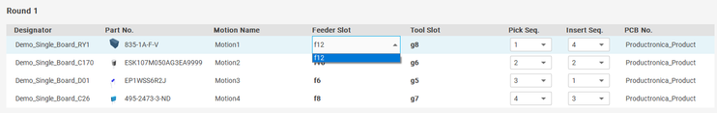
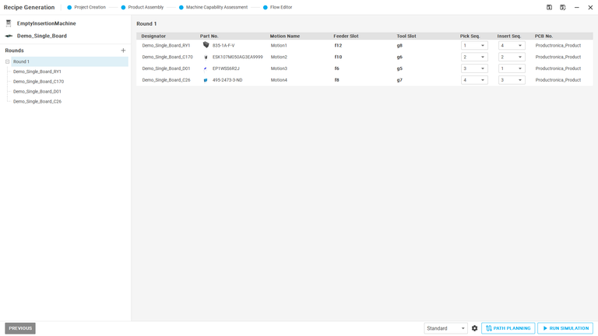
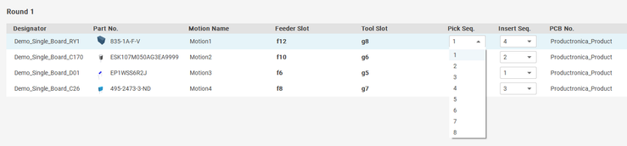
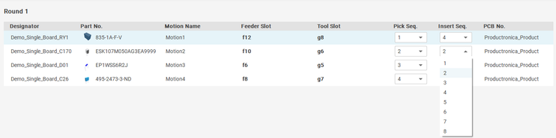
DIATwin MachinePilot Training Kit
Scenario 1 | Fully Automatic Single Board
Review the Process Flow
Page 18 of 20
Check the components, tools, and operation sequence for your single-board product.
Step 4 of 5
01
1
Prepare
In Flow Editor, check designators, feeder/tool slots, and operation order.
2
Parts
Fig. 1-25a Tool / feeder steps
3
Product
4
Recipe
Fig. 1-25b Pickup order
5
Results
Fig. 1-25 Process overview
Fig. 1-25c Insert order
Page 32
Notes:
{"使用者母版頁": 20, "原教材頁": 20, "整合單元來源頁": 189, "每頁建議分鐘": "3–5", "來源界線": "畫面沿用舊連板配方範例；本次選自己的四料單板，數量、尺寸與時間依實際結果。", "目標": "核對Tool／Feeder與生成流程，執行必要規劃，保持自動配置結果。", "未補齊證據": ["QS01-GAP-01", "G-CHECK"], "截圖處理": "保留真實介面；來源有文字帶者改用既有無文字帶出版截圖；單元局部圖沿用原圖裁切與來源。"}

Slide 19
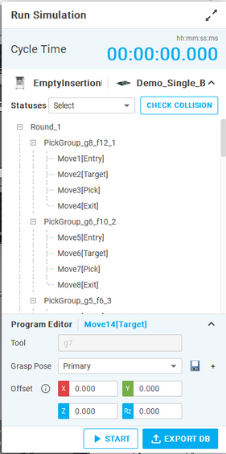
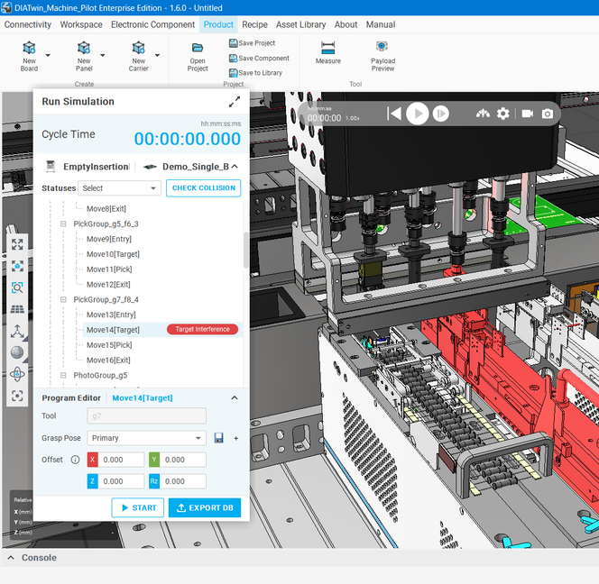

DIATwin MachinePilot Training Kit
Scenario 1 | Fully Automatic Single Board
Check Collisions and Simulation Controls
Page 19 of 20
Check collisions, then run the simulation and review the cycle time.
Step 4 of 5
01
1
Prepare
Check collisions.
2
Parts
3
Product
4
Recipe
Grasp Pose: tool pose
Offset: adjust point
START: run
EXPORT DB: recipe
5
Results
Fig. 1-26 Simulation controls
Fig. 1-27 Collision results
Page 33
Notes:
{"使用者母版頁": 20, "原教材頁": 20, "整合單元來源頁": 189, "每頁建議分鐘": "3–5", "來源界線": "畫面沿用舊連板配方範例；本次選自己的四料單板，數量、尺寸與時間依實際結果。", "目標": "核對Tool／Feeder與生成流程，執行必要規劃，保持自動配置結果。", "未補齊證據": ["QS01-GAP-01", "G-CHECK"], "截圖處理": "保留真實介面；來源有文字帶者改用既有無文字帶出版截圖；單元局部圖沿用原圖裁切與來源。"}

Slide 20
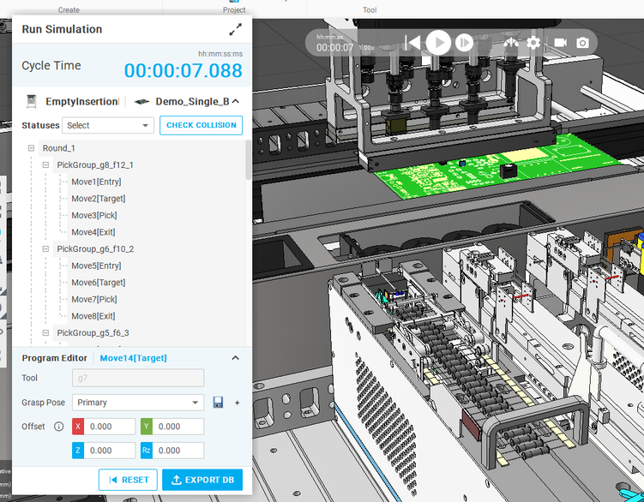

DIATwin MachinePilot Training Kit
Scenario 1 | Fully Automatic Single Board
Initialize and Run the Simulation
Page 20 of 20
Select your four-part single board. The panel illustrates the settings; use your product values.
Step 5 of 5
01
1
Prepare
Run Simulation; wait until Start is available.
2
Parts
02
Start; watch motion and CT until completion.
3
Product
4
Recipe
5
Results
Fig. 1-29 Export the D30 machine recipe
Fig. 1-28 Simulation in progress
Page 34
Notes:
{"使用者母版頁": 21, "原教材頁": 21, "整合單元來源頁": 189, "每頁建議分鐘": "3–5", "來源界線": "畫面沿用舊連板配方範例；本次選自己的四料單板，數量、尺寸與時間依實際結果。", "目標": "沿用同次未手動修改的配置模擬，觀察加工狀態，不先調整干涉。", "未補齊證據": ["QS01-GAP-01"], "截圖處理": "保留真實介面；來源有文字帶者改用既有無文字帶出版截圖；單元局部圖沿用原圖裁切與來源。"}

