Slide 1

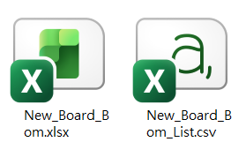
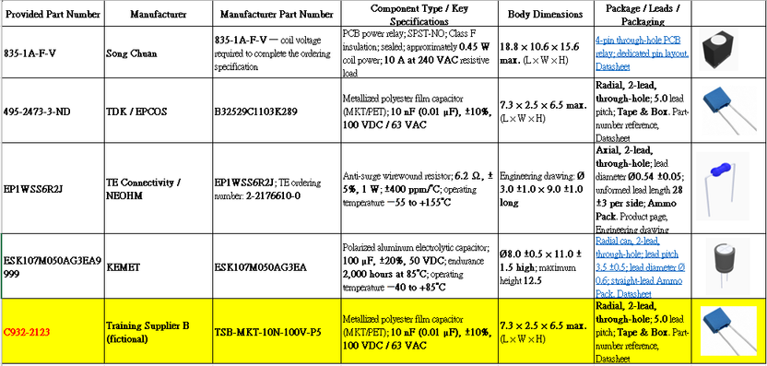
DIATwin MachinePilot Training Kit
Scenario 2 | New Part and Front-Side Feeding
Scenario 2: New Part Number, Same Geometry, Front-Side Feeding
Page 1 of 18
Step 1 of 5
Updated Materials
1
Prepare
Use the five-part BOM, part-number table, and the same board and Gerber data.
2
New Part
New Component Identity
3
C932-2123: same training shape/specs; different supplier and supplier part number.
Update
Product
4
Configure
On-Site Configuration Requirement
Install all feeders within the confirmed front-side area of the machine.
5
Results
Page 35
Notes:
{"使用者母版頁": 23, "原教材頁": 23, "整合單元來源頁": null, "每頁建議分鐘": "3–5", "來源界線": "", "目標": "一頁準備五料BOM／零件表、原元件、同一Gerber、目標位置及機台前側／槽位圖，說明新增C932-2123與供料限制。", "未補齊證據": ["G-S2-PART", "S2-GAP-02"], "截圖處理": "保留真實介面；來源有文字帶者改用既有無文字帶出版截圖；單元局部圖沿用原圖裁切與來源。"}

Slide 2
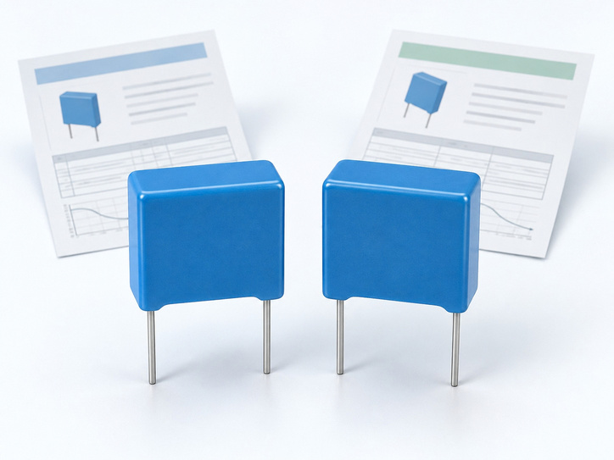
DIATwin MachinePilot Training Kit
Scenario 2 | New Part and Front-Side Feeding
Quick Start: From a New Part to Front-Side Feeding
Page 2 of 18
Step 1 of 5
Component and Product
1
Prepare
Use Deep Clone to create the new part. Update the existing product's links and annotations.
2
New Part
Configuration Strategy
3
Restrict the feeder area first, then let the algorithm configure the accessories.
Update
Product
4
Configure
Verification and Simulation
Check front-side feeding and interference, then simulate and review cycle time. This chapter focuses on the new part and area constraints.
5
Results
Page 36
Notes:
{"使用者母版頁": 24, "原教材頁": 24, "整合單元來源頁": null, "每頁建議分鐘": "3–5", "來源界線": "", "目標": "用圖示呈現新舊料、Deep Clone、既有產品新增連結與標註、保存、機台／產品、前側配置、干涉確認、模擬與CT；不含隱藏2.6／2.7。", "未補齊證據": ["G-S2-PART", "S2-GAP-03", "G-CHECK"], "截圖處理": "保留真實介面；來源有文字帶者改用既有無文字帶出版截圖；單元局部圖沿用原圖裁切與來源。"}

Slide 3
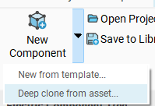
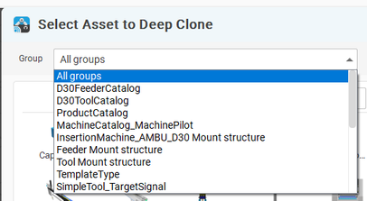
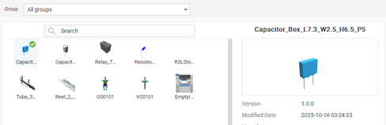
DIATwin MachinePilot Training Kit
Scenario 2 | New Part and Front-Side Feeding
Open Deep Clone
Page 3 of 18
Use C932-2123 in place of the example part number. Keep it consistent across groups.
Step 2 of 5
01
1
Prepare
New Component → Deep Clone from Asset.
Fig. 2-01a Open Electronic Component
2
New Part
02
Set Group to All Groups. Browse the thumbnails, select the blue rectangular capacitor, and click OK.
3
Update
Product
4
Configure
Fig. 2-01b Deep Clone
Fig. 2-01c All Groups
5
Results
Fig. 2-01d Select geometry
Page 37
Notes:
{"使用者母版頁": 26, "原教材頁": 26, "整合單元來源頁": 142, "每頁建議分鐘": "3–5", "來源界線": "本情境新料號為 C932-2123；畫面中的 495-2473-4 是舊操作範例。", "目標": "核對原元件後Deep Clone，設定新名稱與C932-2123，確認沒有覆寫原件。", "未補齊證據": ["G-S2-PART"], "截圖處理": "保留真實介面；來源有文字帶者改用既有無文字帶出版截圖；單元局部圖沿用原圖裁切與來源。"}

Slide 4
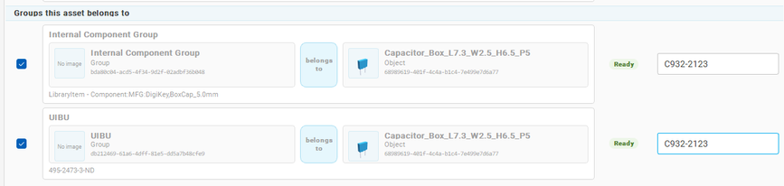
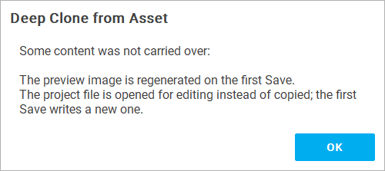
DIATwin MachinePilot Training Kit
Scenario 2 | New Part and Front-Side Feeding
Set the New Name and Group Part Numbers
Page 4 of 18
Use C932-2123 in place of the example part number. Keep it consistent across groups.
Step 2 of 5
01
1
Prepare
Set the asset name and both group part numbers to C932-2123; click OK.
2
New Part
02
3
Update
Product
Read the Deep Clone from Asset reminder and click OK to return to the cloned asset editor. The preview and project file still require an initial save.
Fig. 2-01e New part number
4
Configure
5
Results
Page 38
Fig. 2-01f Clone completed
Notes:
{"使用者母版頁": 26, "原教材頁": 26, "整合單元來源頁": 143, "每頁建議分鐘": "3–5", "來源界線": "本情境新料號為 C932-2123；畫面中的 495-2473-4 是舊操作範例。", "目標": "核對原元件後Deep Clone，設定新名稱與C932-2123，確認沒有覆寫原件。", "未補齊證據": ["G-S2-PART"], "截圖處理": "保留真實介面；來源有文字帶者改用既有無文字帶出版截圖；單元局部圖沿用原圖裁切與來源。"}

Slide 5
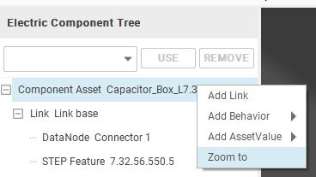
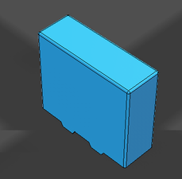
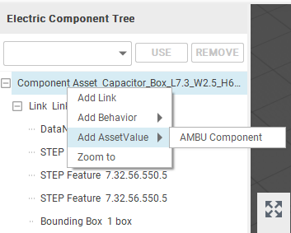
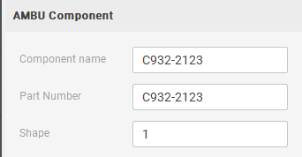
DIATwin MachinePilot Training Kit
Scenario 2 | New Part and Front-Side Feeding
Add AMBU Component Properties
Page 5 of 18
Use C932-2123 in place of the example part number. Keep it consistent across groups.
Step 2 of 5
01
1
Prepare
Right-click the cloned asset root → Add Asset Property → AMBU Component.
2
New Part
02
Select AMBU Component. On the right, set Component Name and Part Number to C932-2123.
3
Update
Product
Fig. 2-02a Zoom to component
Fig. 2-02b Component Feature
4
Configure
5
Results
Fig. 2-02c AMBU Component properties
Fig. 2-02d Part number
Page 39
Notes:
{"使用者母版頁": 27, "原教材頁": 27, "整合單元來源頁": 144, "每頁建議分鐘": "3–5", "來源界線": "本情境新料號為 C932-2123；畫面中的 495-2473-4 是舊操作範例。", "目標": "核對必要群組料號及Component資料，保存新資產與預覽，使用欄位對照圖。", "未補齊證據": ["G-S2-PART"], "截圖處理": "保留真實介面；來源有文字帶者改用既有無文字帶出版截圖；單元局部圖沿用原圖裁切與來源。"}

Slide 6
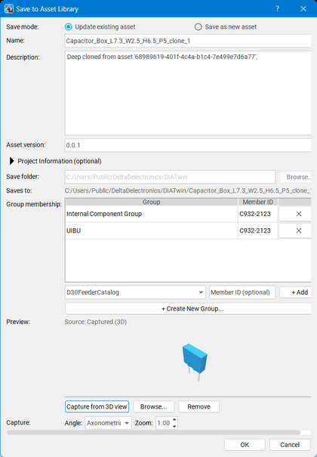
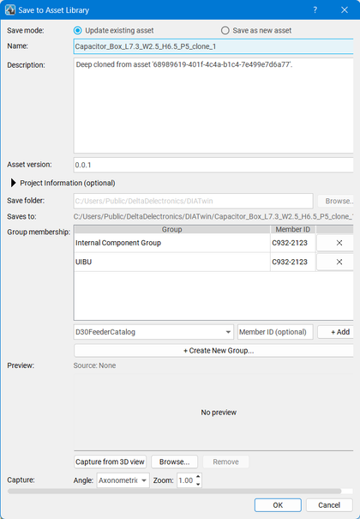
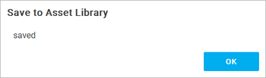
DIATwin MachinePilot Training Kit
Scenario 2 | New Part and Front-Side Feeding
Save the Cloned Asset
Page 6 of 18
Use C932-2123 in place of the example part number. Keep it consistent across groups.
Step 2 of 5
01
Click Save to Library. Check the name, save location, and group part number. Under Preview, click Capture from 3D View. Verify the cloned capacitor geometry, then click OK.
Name: geometry asset name
1
Prepare
Description: General information about the new component
2
New Part
3
Update
Product
Group Membership:
Add Internal Component Group and UIBU. Set the Member ID in both groups to C932-2123.
4
Configure
5
Results
Page 40
Fig. 2-02e Capture from 3D
Fig. 2-02f Save to library
Fig. 2-02g Saved
Notes:
{"使用者母版頁": 27, "原教材頁": 27, "整合單元來源頁": 145, "每頁建議分鐘": "3–5", "來源界線": "本情境新料號為 C932-2123；畫面中的 495-2473-4 是舊操作範例。", "目標": "核對必要群組料號及Component資料，保存新資產與預覽，使用欄位對照圖。", "未補齊證據": ["G-S2-PART"], "截圖處理": "保留真實介面；來源有文字帶者改用既有無文字帶出版截圖；單元局部圖沿用原圖裁切與來源。"}

Slide 7
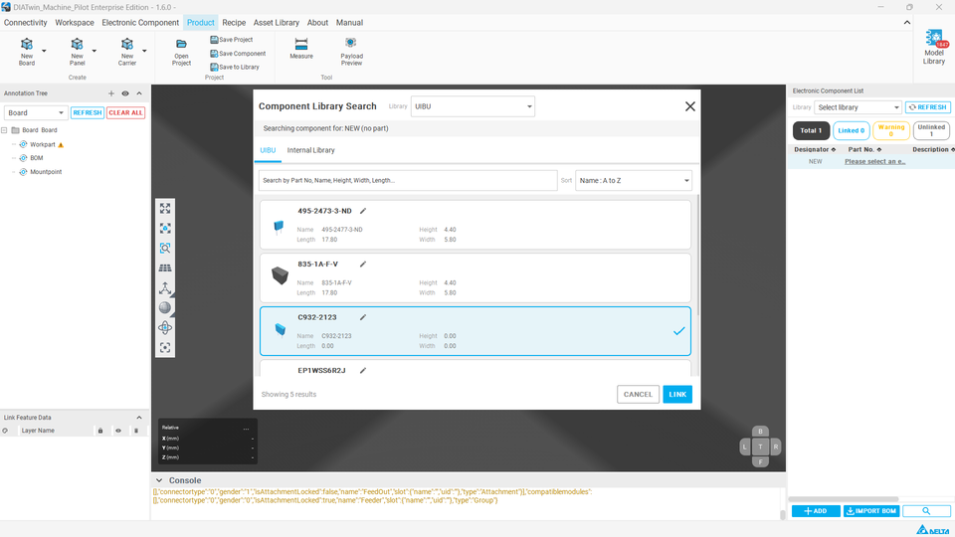
DIATwin MachinePilot Training Kit
Scenario 2 | New Part and Front-Side Feeding
Open the Existing Product and Link the New Part
Page 7 of 18
Use C932-2123 in place of the example part number. Keep it consistent across groups.
Step 3 of 5
01
1
Prepare
Open Demo_Single_Board. Add a BOM item and click its part-number link. Find and link C932-2123 in the user database.
2
New Part
02
3
Update
Product
Keep the original four parts. Add the fifth designator; check the updated list and Gerber location.
4
Configure
5
Results
Fig. 2-03 Find part in BOM
Page 41
Notes:
{"使用者母版頁": 28, "原教材頁": 28, "整合單元來源頁": 146, "每頁建議分鐘": "3–5", "來源界線": "本情境新料號為 C932-2123；畫面中的 495-2473-4 是舊操作範例。", "目標": "確認新舊料號並存，Product能找到新料，未驗證的重開結果不宣稱完成。", "未補齊證據": ["G-S2-PART"], "截圖處理": "保留真實介面；來源有文字帶者改用既有無文字帶出版截圖；單元局部圖沿用原圖裁切與來源。"}

Slide 8

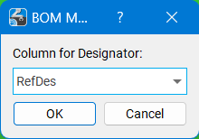
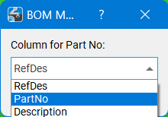
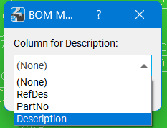
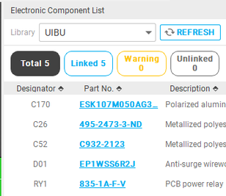
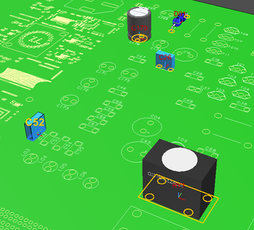
DIATwin MachinePilot Training Kit
Scenario 2 | New Part and Front-Side Feeding
Update Product Links and Annotations
Page 8 of 18
Step 3 of 5
Fig. 2-04a Import BOM
Open Demo_Single_Board
1
Prepare
Check the original four-part BOM links and annotations. Retain the existing content.
2
New Part
Add a Product Part-Number Link
Add C932-2123 and identify a suitable additional location in the same Gerber data.
3
Update
Product
Fig. 2-04b Column mapping
4
Configure
Create the New Product Annotation
Box-select the footprint for the confirmed designator and check its orientation.
5
Results
Fig. 2-04c Imported BOM
Fig. 2-04d Annotations
Page 42
Notes:
{"使用者母版頁": 29, "原教材頁": 29, "整合單元來源頁": null, "每頁建議分鐘": "3–5", "來源界線": "", "目標": "開啟既有Demo_Single_Board，核對原四料及標註，於產品新增並連結C932-2123，再完成新增位置的產品標註；保留原四料標註，TBD位置必須先依Gerber核對。", "未補齊證據": ["G-S2-PART"], "截圖處理": "保留真實介面；來源有文字帶者改用既有無文字帶出版截圖；單元局部圖沿用原圖裁切與來源。"}

Slide 9
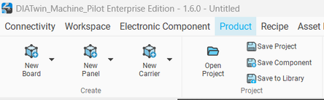
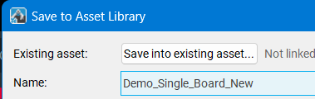
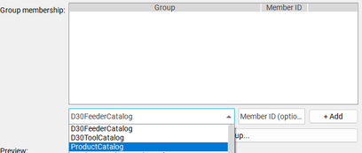
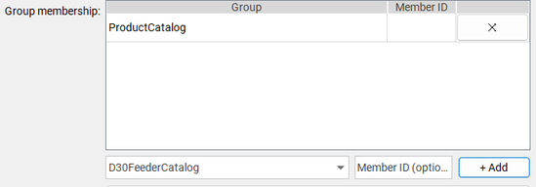
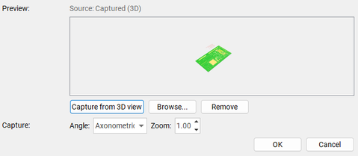
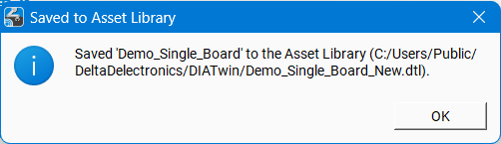
DIATwin MachinePilot Training Kit
Scenario 2 | New Part and Front-Side Feeding
Preview and Save the Five-Part Product
Page 9 of 18
Step 3 of 5
Save the Updated Version
Use a clear name and version with the latest preview. After saving, find the product in Recipe.
1
Prepare
Fig. 2-05a Save to Library and name the product
2
New Part
3
Update
Product
4
Configure
Fig. 2-05b Add the product to Product Catalog
5
Results
Page 43
Fig. 2-05c Capture preview and save
Notes:
{"使用者母版頁": 30, "原教材頁": 30, "整合單元來源頁": null, "每頁建議分鐘": "3–5", "來源界線": "", "目標": "以整體結果核對原四料與新增料，完成預覽與保存。", "未補齊證據": ["G-S2-PART"], "截圖處理": "保留真實介面；來源有文字帶者改用既有無文字帶出版截圖；單元局部圖沿用原圖裁切與來源。"}

Slide 10
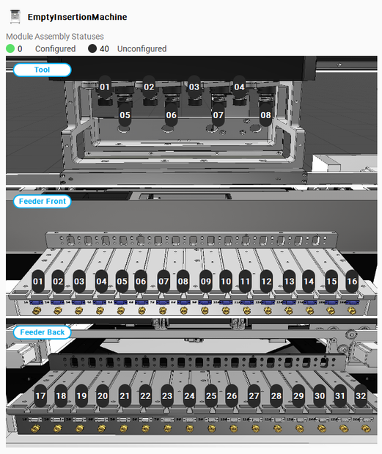
DIATwin MachinePilot Training Kit
Scenario 2 | New Part and Front-Side Feeding
Confirm the Machine Front and Allowed Area
Page 10 of 18
Step 4 of 5
Understand the Site Requirement
1
Prepare
Constraints
Feeders: front-side slots 1–16 only.
Tools: front-side slots 1–4.
2
New Part
Learn the Software Settings
3
Apply settings that meet the
current constraints.
Update
Product
4
Configure
5
Results
Page 44
Fig. 2-06 Machine slots
Notes:
{"使用者母版頁": 31, "原教材頁": 31, "整合單元來源頁": null, "每頁建議分鐘": "3–5", "來源界線": "", "目標": "用前側照片與槽位對照圖說明可用區域，不把舊槽號當作前後側證據。", "未補齊證據": ["S2-GAP-02"], "截圖處理": "保留真實介面；來源有文字帶者改用既有無文字帶出版截圖；單元局部圖沿用原圖裁切與來源。"}

Slide 11
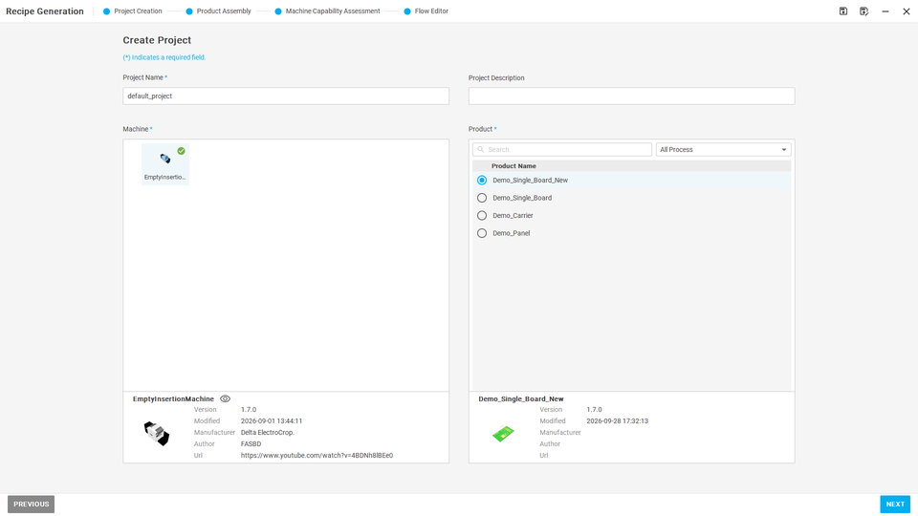
DIATwin MachinePilot Training Kit
Scenario 2 | New Part and Front-Side Feeding
Select the Machine and Updated Product
Page 11 of 18
Select the product first, then set loading conditions. Feeder-area restrictions follow in the next steps.
Step 4 of 5
01
1
Prepare
In Recipe → Create Project, select the empty machine and the saved Demo_Single_Board_New.
2
New Part
3
Update
Product
4
Configure
5
Results
Fig. 2-07 New project
Page 45
Notes:
{"使用者母版頁": 32, "原教材頁": 32, "整合單元來源頁": 179, "每頁建議分鐘": "3–5", "來源界線": "畫面沿用載具配置範例；本次以五料產品與現場前側槽位對照圖為準。", "目標": "選更新產品建立Recipe，確認指定槽位為空後鎖定不可用區域，說明Lock保留當前狀態。", "未補齊證據": ["S2-GAP-02", "S2-GAP-03"], "截圖處理": "保留真實介面；來源有文字帶者改用既有無文字帶出版截圖；單元局部圖沿用原圖裁切與來源。"}

Slide 12
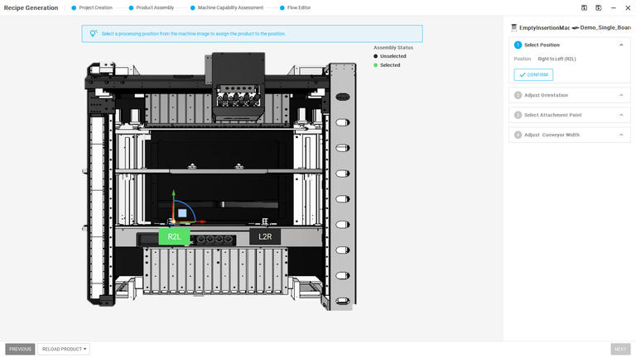
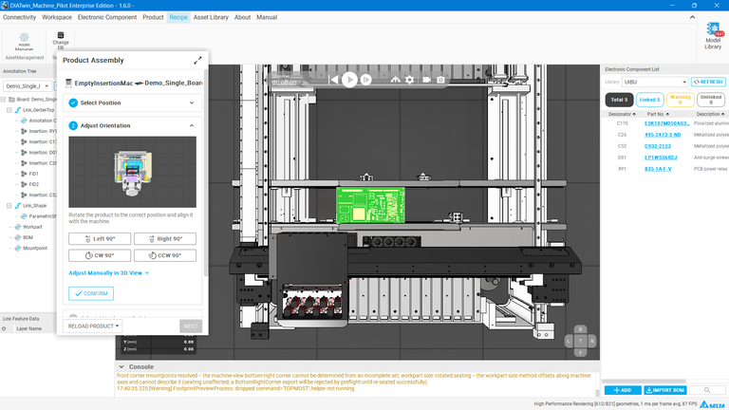
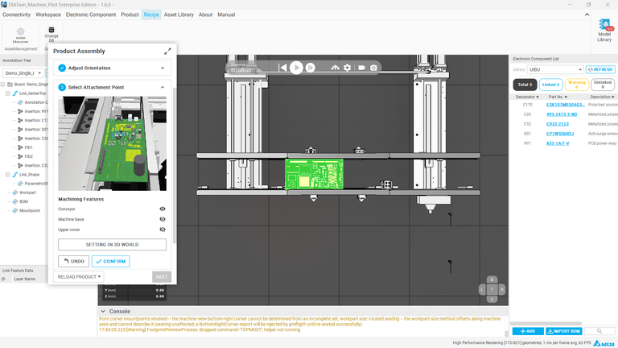
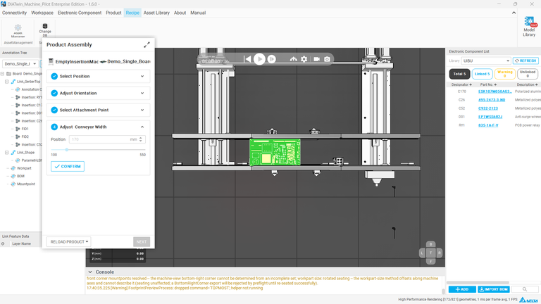
DIATwin MachinePilot Training Kit
Scenario 2 | New Part and Front-Side Feeding
Mount the Product in the Machine
Page 12 of 18
Step 4 of 5
1
Prepare
2
New Part
3
Update
Product
4
Configure
5
Results
Page 46
Fig. 2-08 Mounting
Notes:
{"使用者母版頁": 32, "原教材頁": 32, "整合單元來源頁": 179, "每頁建議分鐘": "3–5", "來源界線": "畫面沿用載具配置範例；本次以五料產品與現場前側槽位對照圖為準。", "目標": "選更新產品建立Recipe，確認指定槽位為空後鎖定不可用區域，說明Lock保留當前狀態。", "未補齊證據": ["S2-GAP-02", "S2-GAP-03"], "截圖處理": "保留真實介面；來源有文字帶者改用既有無文字帶出版截圖；單元局部圖沿用原圖裁切與來源。"}

Slide 13
DIATwin MachinePilot Training Kit
Scenario 2 | New Part and Front-Side Feeding
Configuration Settings
Page 13 of 18
Step 4 of 5
1
Prepare
Fig. 2-09a Keep slot 01 empty
2
New Part
Fig. 2-09b Slot 02 enabled, kept empty
3
Update
Product
4
Configure
Fig. 2-09c Use slot 07 with a Tube_3_box feeder for part 835-1A-F-V
5
Results
Fig. 2-09d Slot 09 unlocked: the feeder can be reassigned
Page 47
Notes:
{"使用者母版頁": 32, "原教材頁": 32, "整合單元來源頁": 179, "每頁建議分鐘": "3–5", "來源界線": "畫面沿用載具配置範例；本次以五料產品與現場前側槽位對照圖為準。", "目標": "選更新產品建立Recipe，確認指定槽位為空後鎖定不可用區域，說明Lock保留當前狀態。", "未補齊證據": ["S2-GAP-02", "S2-GAP-03"], "截圖處理": "保留真實介面；來源有文字帶者改用既有無文字帶出版截圖；單元局部圖沿用原圖裁切與來源。"}

Slide 14
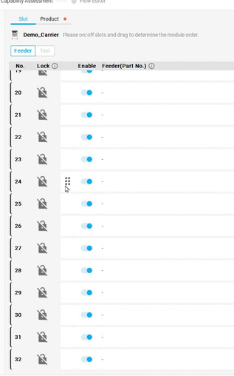
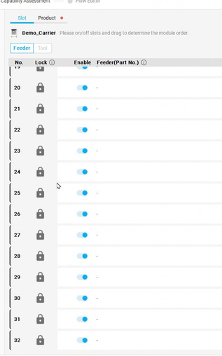
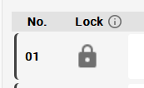
DIATwin MachinePilot Training Kit
Scenario 2 | New Part and Front-Side Feeding
Identify Slots That Must Remain Empty
Page 14 of 18
Select the five-part product. Identify front-side slots on the machine layout and set the restrictions.
Step 4 of 5
01
1
Prepare
Open the feeder slots. Check the machine diagram; confirm front-side slots 1–16.
2
New Part
02
Verify the front/rear slot mapping. Lock prohibited empty slots; this example locks 17–32.
3
Update
Product
4
Configure
5
Results
Fig. 2-10a Find empty slots
Fig. 2-10b Lock feeder slots
Fig. 2-10c Lock / unlock all slots
Page 48
Notes:
{"使用者母版頁": 32, "原教材頁": 32, "整合單元來源頁": 180, "每頁建議分鐘": "3–5", "來源界線": "畫面沿用載具配置範例；本次以五料產品與現場前側槽位對照圖為準。", "目標": "選更新產品建立Recipe，確認指定槽位為空後鎖定不可用區域，說明Lock保留當前狀態。", "未補齊證據": ["S2-GAP-02", "S2-GAP-03"], "截圖處理": "保留真實介面；來源有文字帶者改用既有無文字帶出版截圖；單元局部圖沿用原圖裁切與來源。"}

Slide 15
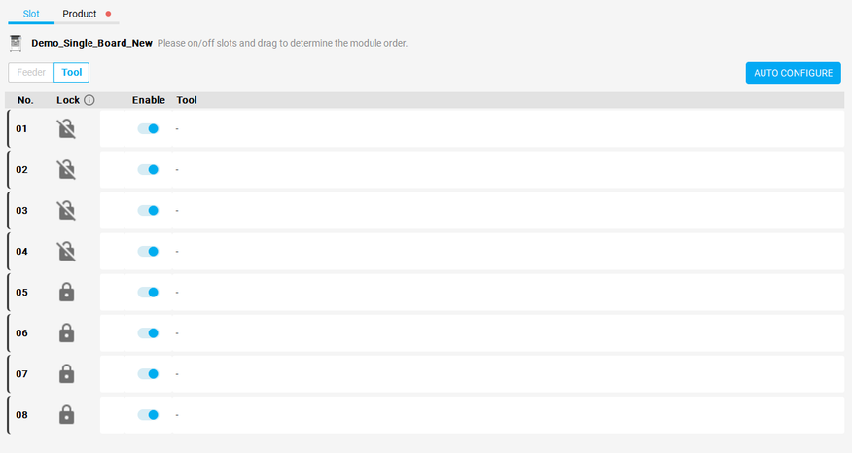
DIATwin MachinePilot Training Kit
Scenario 2 | New Part and Front-Side Feeding
Set the Tool Slot Restrictions
Page 15 of 18
Select the five-part product. Identify front-side slots on the machine layout and set the restrictions.
Step 4 of 5
01
Fig. 2-10e Auto-configure within limits
1
Prepare
Keep tool slots 1–4 available for this task.
2
New Part
02
Keep tool slots 1–4 available. Lock empty slots 5–8, then auto-configure.
3
Update
Product
4
Configure
5
Results
Fig. 2-10d Lock empty tool slots
Page 49
Notes:
{"使用者母版頁": 32, "原教材頁": 32, "整合單元來源頁": 181, "每頁建議分鐘": "3–5", "來源界線": "畫面沿用載具配置範例；本次以五料產品與現場前側槽位對照圖為準。", "目標": "選更新產品建立Recipe，確認指定槽位為空後鎖定不可用區域，說明Lock保留當前狀態。", "未補齊證據": ["S2-GAP-02", "S2-GAP-03"], "截圖處理": "保留真實介面；來源有文字帶者改用既有無文字帶出版截圖；單元局部圖沿用原圖裁切與來源。"}

Slide 16
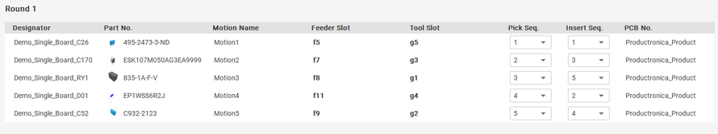
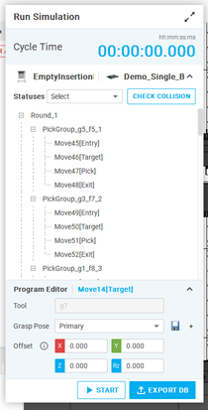
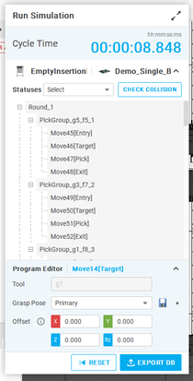
DIATwin MachinePilot Training Kit
Scenario 2 | New Part and Front-Side Feeding
Check Interference, Then Simulate
Page 16 of 18
Select the five-part product. Identify front-side slots on the machine layout and set the restrictions.
Step 5 of 5
01
1
Prepare
Next → Flow Editor. Check pick/insert order, then collisions.
2
New Part
02
Run Simulation; after initialization, click Start. Keep the cycle time and warnings for review.
3
Update
Product
4
Configure
5
Results
Page 50
Fig. 2-11 Setup and Flow Editor
Fig. 2-12 Check / simulate
Notes:
{"使用者母版頁": 35, "原教材頁": 35, "整合單元來源頁": 184, "每頁建議分鐘": "3–5", "來源界線": "畫面沿用載具配置範例；本次以五料產品與現場前側槽位對照圖為準。", "目標": "同頁呈現流程與模擬結果，核對前側要求、加工範圍、CT與警告；操作引用已學方法。", "未補齊證據": ["S2-GAP-03", "G-CHECK"], "截圖處理": "保留真實介面；來源有文字帶者改用既有無文字帶出版截圖；單元局部圖沿用原圖裁切與來源。"}

Slide 17
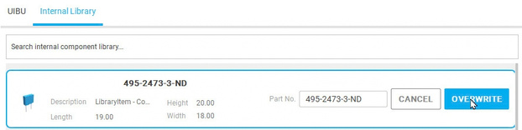
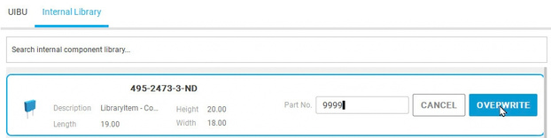

DIATwin MachinePilot Training Kit
Scenario 2 | New Part and Front-Side Feeding
Modify a Part Number
Page 17 of 18
Step 2 of 5
01
1
Prepare
Internal database: find the original part and shape.
2
New Part
02
Add to User Database, or edit Part Number directly.
Fig. 2-13 Original part number and Overwrite
3
Update
Product
03
Set Part Number to 9999; verify.
4
Configure
04
Fig. 2-14 Change the part number to 9999
Click Overwrite and confirm the successful database update message.
5
Results
Fig. 2-15 Successful update message
Page 51
Notes:
{"使用者母版頁": 25, "原教材頁": 25, "整合單元來源頁": 140, "每頁建議分鐘": "3–5", "來源界線": "延伸辨識：此功能會修改原料號；需要保留原料號時，請使用後續的深層複製。", "目標": "同頁對照相同規格／外形、不同製造商／料號，再圖解重用、修改、複製與新建的適用條件。", "未補齊證據": ["G-S2-PART"], "截圖處理": "保留真實介面；來源有文字帶者改用既有無文字帶出版截圖；單元局部圖沿用原圖裁切與來源。"}

Slide 18
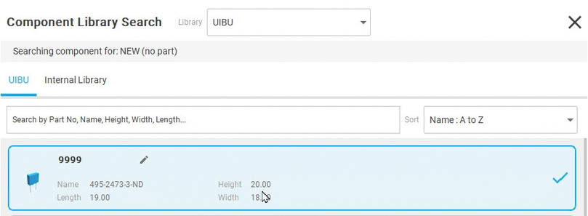
DIATwin MachinePilot Training Kit
Scenario 2 | New Part and Front-Side Feeding
Verify the Update and Completion
Page 18 of 18
This changes the original part number. To retain it, use Deep Clone as explained earlier in this chapter.
Step 2 of 5
01
1
Prepare
Return to the user database.
02
2
New Part
Find the edited blue capacitor. Check its new part number.
3
Update
Product
03
Completion Check
4
Configure
04
□ Geometry unchanged.
□ Part no.: 9999 or assigned.
□ Update confirmed.
□ Check part no. vs. asset name.
5
Results
Fig. 2-16 The user database shows the new part number 9999
Page 52
Notes:
{"使用者母版頁": 25, "原教材頁": 25, "整合單元來源頁": 141, "每頁建議分鐘": "3–5", "來源界線": "延伸辨識：此功能會修改原料號；需要保留原料號時，請使用後續的深層複製。", "目標": "同頁對照相同規格／外形、不同製造商／料號，再圖解重用、修改、複製與新建的適用條件。", "未補齊證據": ["G-S2-PART"], "截圖處理": "保留真實介面；來源有文字帶者改用既有無文字帶出版截圖；單元局部圖沿用原圖裁切與來源。"}

