Slide 1

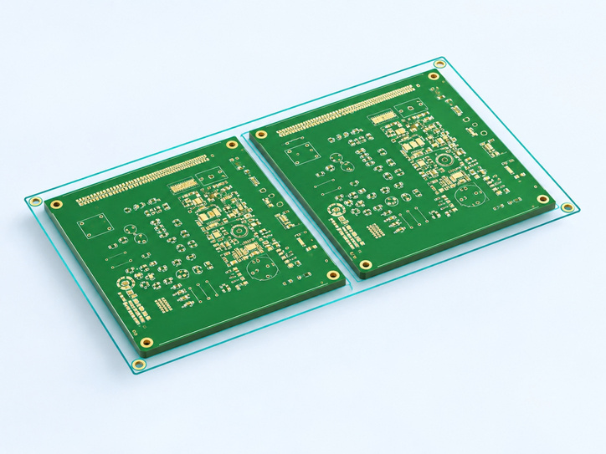
DIATwin MachinePilot Training Kit
Scenario 3 | Panel and Specified Configuration
Scenario 3: Build a Two-Board Panel
Page 1 of 18
Step 1 of 5
Prepare the Inputs
1
Prepare
Prepare Demo_Single_Board, the four-part BOM, panel drawing, and given machine setup.
2
Panel
Product Requirement
3
Create two instances from the drawing. PCB1 and PCB2 are the resulting board instances.
Fixed
Setup
4
Mode
Planning Goal
Keep the given configuration and compare board-by-board and whole-panel planning. Check the drawing dimensions before starting.
5
Compare
Page 53
Notes:
{"使用者母版頁": 36, "原教材頁": 43, "整合單元來源頁": null, "每頁建議分鐘": "3–5", "來源界線": "", "目標": "一頁圖解單板、四料表、連板配置圖及給定機台配置；兩板是成果，八位置表為參考，圖面尺寸須確認。", "未補齊證據": ["S3-GAP-05", "S3-GAP-02"], "截圖處理": "保留真實介面；來源有文字帶者改用既有無文字帶出版截圖；單元局部圖沿用原圖裁切與來源。"}

Slide 2
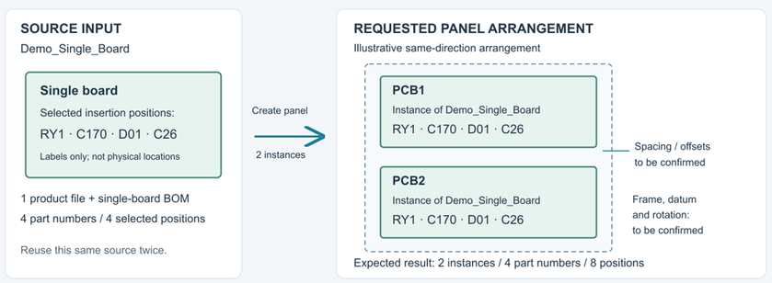
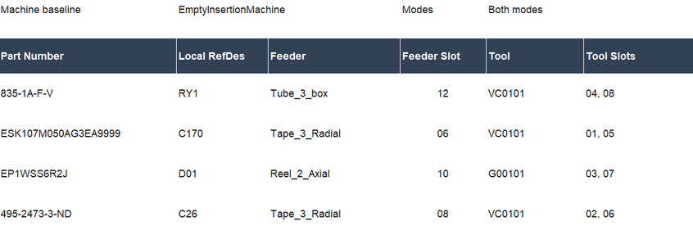
DIATwin MachinePilot Training Kit
Scenario 3 | Panel and Specified Configuration
Quick Start: Two Boards, Two Planning Scopes
Page 2 of 18
Step 1 of 5
Create and Save
1
Prepare
Use the source board and layout drawing to create two child-board instances.
2
Panel
Keep the Specified Configuration
3
Check feeders, tools, and slots. Keep the same resource conditions.
Fixed
Setup
Fig. 3-01a Panel-board definition
4
Mode
Compare Processing Scopes
Check interference and simulate both modes. Compare actual results; do not assume whole-panel planning is faster.
5
Compare
Page 54
Fig. 3-01b Machine setup
Notes:
{"使用者母版頁": 37, "原教材頁": 44, "整合單元來源頁": null, "每頁建議分鐘": "3–5", "來源界線": "", "目標": "用概念圖呈現一份單板依圖成為二連板、保存、選機台／產品、給定配置、干涉確認、兩模式模擬及CT判讀；不預設跨板較快。", "未補齊證據": ["S3-GAP-04"], "截圖處理": "保留真實介面；來源有文字帶者改用既有無文字帶出版截圖；單元局部圖沿用原圖裁切與來源。"}

Slide 3
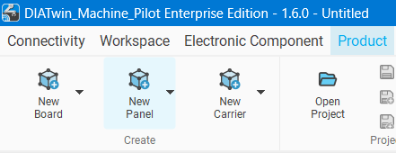
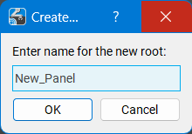
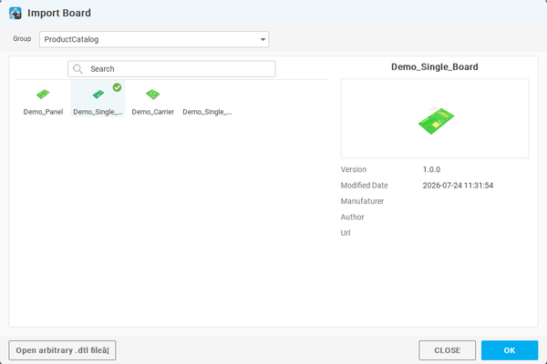
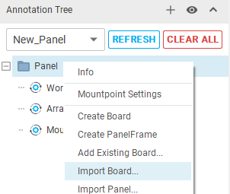
DIATwin MachinePilot Training Kit
Scenario 3 | Panel and Specified Configuration
Create a Panel
Page 3 of 18
Step 2 of 5
01
1
Prepare
Product → New Panel. Name it; click OK.
2
Panel
02
Fig. 3-02a New panel
Fig. 3-02b Panel name
Right-click the panel root → Import Board. Select Product Catalog, choose Demo_Single_Board, and click OK.
3
Fixed
Setup
4
Mode
5
Compare
Page 55
Fig. 3-02c Import board
Notes:
{"使用者母版頁": 38, "原教材頁": 45, "整合單元來源頁": 156, "每頁建議分鐘": "3–5", "來源界線": "", "目標": "同頁建立Panel、載入單板並依圖設定數量及偏移，以排列圖帶設定。", "未補齊證據": ["S3-GAP-05"], "截圖處理": "保留真實介面；來源有文字帶者改用既有無文字帶出版截圖；單元局部圖沿用原圖裁切與來源。"}

Slide 4
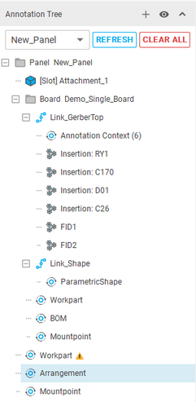
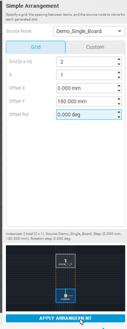
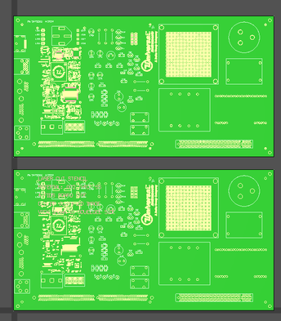
DIATwin MachinePilot Training Kit
Scenario 3 | Panel and Specified Configuration
Set the Arrangement
Page 4 of 18
Step 2 of 5
01
1
Prepare
Set Arrangement:
  Source: Demo_Single_Board
  Count (top to bottom): 2, 1
  Offset X=0, Y=180 mm; rotation 0°.
2
Panel
3
Fixed
Setup
02
4
Mode
Click Apply Arrangement. Check the new child board and the 3D arrangement.
5
Compare
Fig. 3-02d Arrangement
Page 56
Notes:
{"使用者母版頁": 39, "原教材頁": 46, "整合單元來源頁": 157, "每頁建議分鐘": "3–5", "來源界線": "", "目標": "套用後核對兩個子板的位置、方向及来源身分，觀察結果並說明對應。", "未補齊證據": ["S3-GAP-01", "S3-GAP-05"], "截圖處理": "保留真實介面；來源有文字帶者改用既有無文字帶出版截圖；單元局部圖沿用原圖裁切與來源。"}

Slide 5
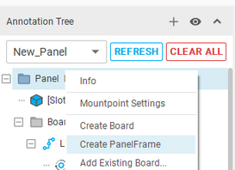
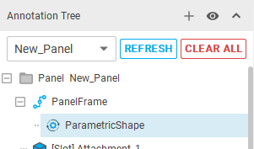
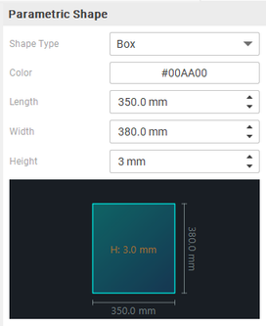
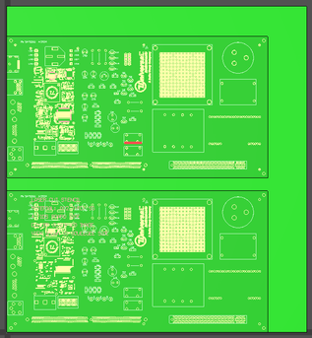
DIATwin MachinePilot Training Kit
Scenario 3 | Panel and Specified Configuration
Create the Panel Frame
Page 5 of 18
Step 2 of 5
01
1
Prepare
Right-click the panel root → Create Panel Frame.
2
Panel
02
Select Panel Frame and a frame color. Set length = 350, width = 380, and height = 3 mm. Click Generate.
Fig. 3-02e Frame node
Fig. 3-02f Frame shape
3
Fixed
Setup
4
Mode
5
Compare
Page 57
Fig. 3-02g Parameters
Fig. 3-02h Panel frame
Notes:
{"使用者母版頁": 40, "原教材頁": 47, "整合單元來源頁": 158, "每頁建議分鐘": "3–5", "來源界線": "", "目標": "組合外框生成、定位及整體Workpart設定，核對本案尺寸及定位資料。", "未補齊證據": ["S3-GAP-05"], "截圖處理": "保留真實介面；來源有文字帶者改用既有無文字帶出版截圖；單元局部圖沿用原圖裁切與來源。"}

Slide 6
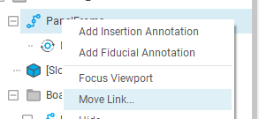
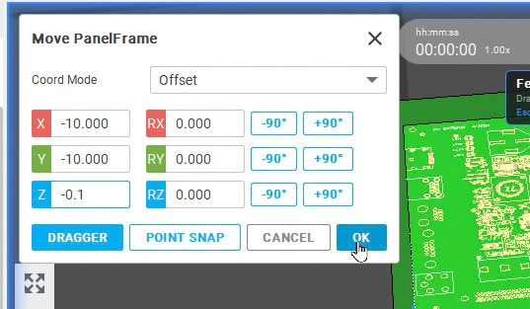
DIATwin MachinePilot Training Kit
Scenario 3 | Panel and Specified Configuration
Adjust the Frame Position
Page 6 of 18
Step 2 of 5
01
1
Prepare
Right-click Panel Frame → Move Geometry Link. Select Offset and set X = −10, Y = −10, Z = −0.1. Click OK.
2
Panel
3
Fixed
Setup
4
Mode
5
Compare
Fig. 3-02i Frame position
Page 58
Notes:
{"使用者母版頁": 40, "原教材頁": 47, "整合單元來源頁": 159, "每頁建議分鐘": "3–5", "來源界線": "", "目標": "組合外框生成、定位及整體Workpart設定，核對本案尺寸及定位資料。", "未補齊證據": ["S3-GAP-05"], "截圖處理": "保留真實介面；來源有文字帶者改用既有無文字帶出版截圖；單元局部圖沿用原圖裁切與來源。"}

Slide 7
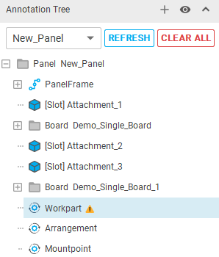
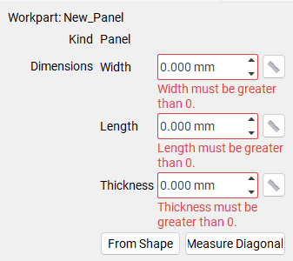
DIATwin MachinePilot Training Kit
Scenario 3 | Panel and Specified Configuration
Measure and Set Panel Workpart Dimensions
Page 7 of 18
Step 2 of 5
01
1
Prepare
Workpart → Measure Diagonal. Select the bottom face's lower-right corner, then the opposite top-face corner.
2
Panel
3
Fixed
Setup
02
Check width 380, length 350, thickness 3 mm against the drawing. Enter thickness manually if needed.
4
Mode
5
Compare
Fig. 3-02j Workpart dimensions
Page 59
Notes:
{"使用者母版頁": 40, "原教材頁": 47, "整合單元來源頁": 160, "每頁建議分鐘": "3–5", "來源界線": "", "目標": "組合外框生成、定位及整體Workpart設定，核對本案尺寸及定位資料。", "未補齊證據": ["S3-GAP-05"], "截圖處理": "保留真實介面；來源有文字帶者改用既有無文字帶出版截圖；單元局部圖沿用原圖裁切與來源。"}

Slide 8
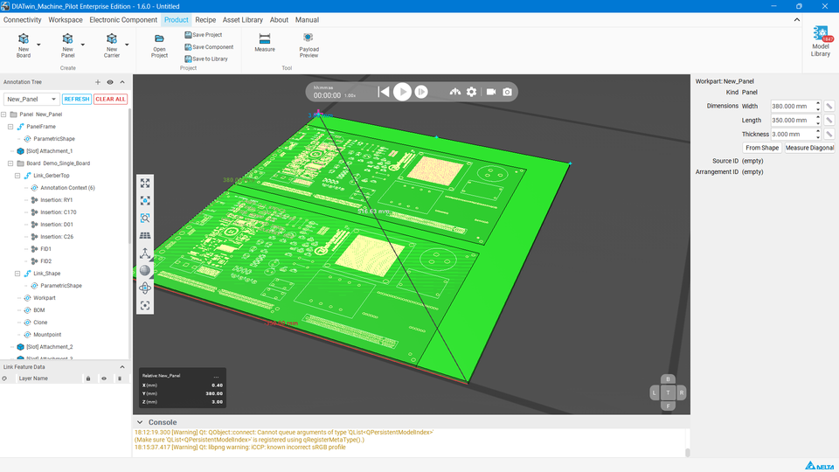
DIATwin MachinePilot Training Kit
Scenario 3 | Panel and Specified Configuration
Check Panel Dimensions and Mount Point
Page 8 of 18
Step 2 of 5
01
1
Prepare
Check the frame dimensions. Right-click Mount Points → Create Mount Point.
2
Panel
3
Fixed
Setup
02
Select Corner Mount Point and check the default work coordinate system. Confirm it belongs to the panel root before saving.
4
Mode
5
Compare
Fig. 3-02k Check frame dimensions
Page 60
Notes:
{"使用者母版頁": 40, "原教材頁": 47, "整合單元來源頁": 160, "每頁建議分鐘": "3–5", "來源界線": "", "目標": "組合外框生成、定位及整體Workpart設定，核對本案尺寸及定位資料。", "未補齊證據": ["S3-GAP-05"], "截圖處理": "保留真實介面；來源有文字帶者改用既有無文字帶出版截圖；單元局部圖沿用原圖裁切與來源。"}

Slide 9
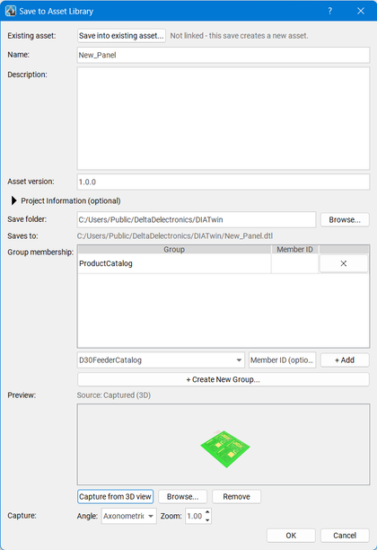
DIATwin MachinePilot Training Kit
Scenario 3 | Panel and Specified Configuration
Save the Panel
Page 9 of 18
Step 2 of 5
01
1
Prepare
Save: check name/path/catalog. Capture from 3D View; OK. Confirm success.
2
Panel
02
Recipe → Create Project: find your saved panel in the Product list.
3
Fixed
Setup
4
Mode
5
Compare
Fig. 3-02l Save panel
Page 61
Notes:
{"使用者母版頁": 41, "原教材頁": 48, "整合單元來源頁": 161, "每頁建議分鐘": "3–5", "來源界線": "", "目標": "保存並核對兩板各四位置、四料各兩顆，結果與數量檢查同頁。", "未補齊證據": ["S3-GAP-01"], "截圖處理": "保留真實介面；來源有文字帶者改用既有無文字帶出版截圖；單元局部圖沿用原圖裁切與來源。"}

Slide 10
DIATwin MachinePilot Training Kit
Scenario 3 | Panel and Specified Configuration
Specified Configuration Example
Page 10 of 18
This case has two boards and eight processing positions. Use the same specified configuration to compare both processing modes.
Step 3 of 5
Part Number
Feeder / Slot
Tool / Slot
1
Prepare
495-2473-3-ND
Tape_3_Radial／08
VC0101／02、06
2
Panel
835-1A-F-V
Tube_3_box／12
VC0101／04、08
3
Fixed
Setup
EP1WSS6R2J
Reel_2_Axial／10
G00101／03、07
4
Mode
ESK107M050AG3EA9999
Tape_3_Radial／06
VC0101／01、05
5
Compare
Use this table to restore or verify the existing setup. This section uses manual assignment; locking is not required.
Page 62
Notes:
{"使用者母版頁": 42, "原教材頁": 49, "整合單元來源頁": 172, "每頁建議分鐘": "3–5", "來源界線": "本次為二連板、共八個加工位置；沿用指定配置，比較兩種加工模式。", "目標": "用四料／配件／槽位表建立Recipe，選本次連板並確認安裝條件。", "未補齊證據": ["S3-GAP-02"], "截圖處理": "保留真實介面；來源有文字帶者改用既有無文字帶出版截圖；單元局部圖沿用原圖裁切與來源。"}

Slide 11
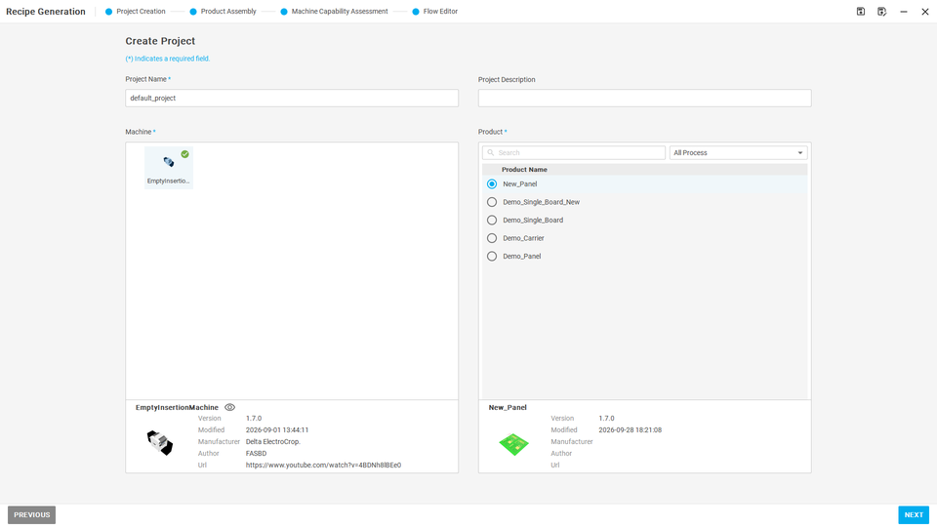
DIATwin MachinePilot Training Kit
Scenario 3 | Panel and Specified Configuration
Select the Machine and Two-Board Product
Page 11 of 18
The two-board panel has eight processing positions. Both modes use the same specified configuration.
Step 3 of 5
01
1
Prepare
In Recipe → Project Creation, click Create Project. Select the empty machine and your saved two-board panel, then click Next.
2
Panel
3
Fixed
Setup
02
Verify two boards and eight processing positions. Prepare to assign feeders and tools from this chapter's configuration table.
4
Mode
5
Compare
Fig. 3-03 Machine / panel
Page 63
Notes:
{"使用者母版頁": 42, "原教材頁": 49, "整合單元來源頁": 173, "每頁建議分鐘": "3–5", "來源界線": "本次為二連板、共八個加工位置；沿用指定配置，比較兩種加工模式。", "目標": "用四料／配件／槽位表建立Recipe，選本次連板並確認安裝條件。", "未補齊證據": ["S3-GAP-02"], "截圖處理": "保留真實介面；來源有文字帶者改用既有無文字帶出版截圖；單元局部圖沿用原圖裁切與來源。"}

Slide 12
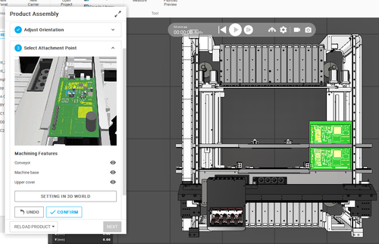
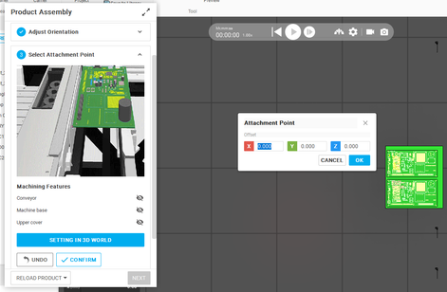
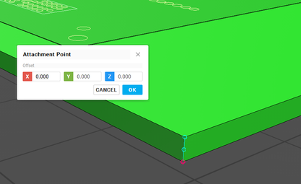
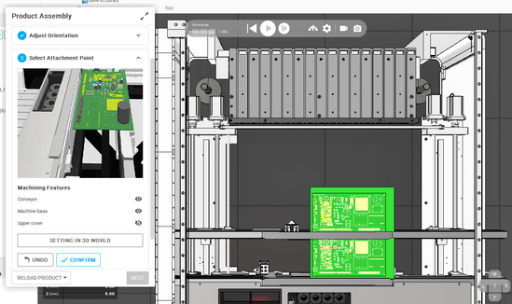
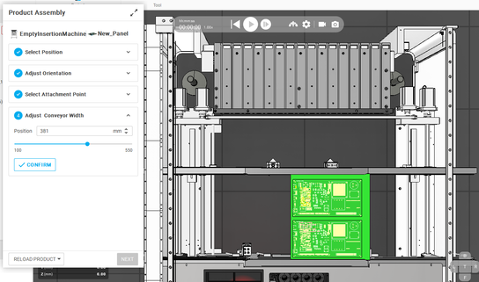
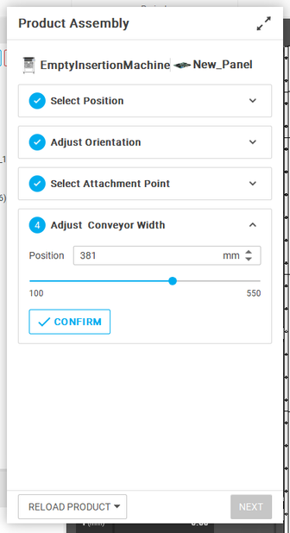
DIATwin MachinePilot Training Kit
Scenario 3 | Panel and Specified Configuration
Mount the Panel in the Machine
Page 12 of 18
Complete loading settings before manually assigning accessories. Retain the existing configuration constraints.
Step 3 of 5
1
Prepare
2
Panel
3
Fixed
Setup
4
Mode
5
Compare
Page 64
Fig. 3-03a Panel mounting
Notes:
{"使用者母版頁": 42, "原教材頁": 49, "整合單元來源頁": 173, "每頁建議分鐘": "3–5", "來源界線": "本次為二連板、共八個加工位置；沿用指定配置，比較兩種加工模式。", "目標": "用四料／配件／槽位表建立Recipe，選本次連板並確認安裝條件。", "未補齊證據": ["S3-GAP-02"], "截圖處理": "保留真實介面；來源有文字帶者改用既有無文字帶出版截圖；單元局部圖沿用原圖裁切與來源。"}

Slide 13

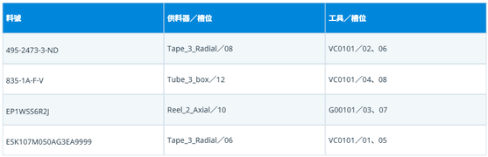
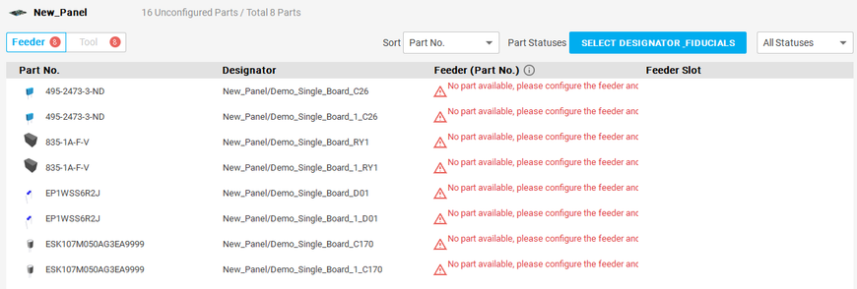
DIATwin MachinePilot Training Kit
Scenario 3 | Panel and Specified Configuration
Assign Feeders Manually
Page 13 of 18
This case has two boards and eight processing positions. Use the same specified configuration to compare both processing modes.
Step 3 of 5
01
1
Prepare
Click the target part's feeder field. Select Tape_3_Radial and click Next. Select slot 08, verify selected slot = 8, and click Finish. Wait for installation; check Tape_3_Radial / 08 for every row of that part. Repeat for other parts using the table.
2
Panel
3
Fixed
Setup
4
Mode
5
Compare
Fig. 3-03b Assign in Product mode
Page 65
Notes:
{"使用者母版頁": 43, "原教材頁": 50, "整合單元來源頁": 174, "每頁建議分鐘": "3–5", "來源界線": "本次為二連板、共八個加工位置；沿用指定配置，比較兩種加工模式。", "目標": "以一組Feeder示範核對或指定，其餘用表格核對；完整多槽跟做另計。", "未補齊證據": ["S3-GAP-02"], "截圖處理": "保留真實介面；來源有文字帶者改用既有無文字帶出版截圖；單元局部圖沿用原圖裁切與來源。"}

Slide 14

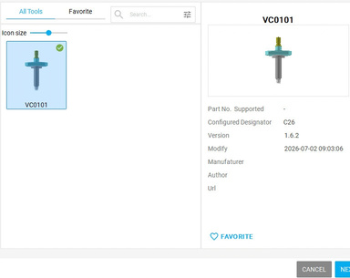
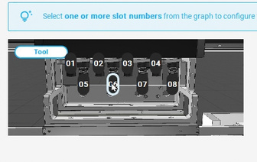
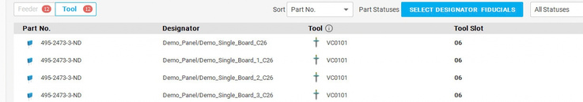
DIATwin MachinePilot Training Kit
Scenario 3 | Panel and Specified Configuration
Assign Tools Manually
Page 14 of 18
This case has two boards and eight processing positions. Use the same specified configuration to compare both processing modes.
Step 3 of 5
01
1
Prepare
Open Product → Tool and click the tool field. Select VC0101, then Next. For the full example, select 02 and 06 in order (no Ctrl), check, then Finish. After installation, verify tools and slots; repeat from the table. The right image shows slot 06 only: select 06 and Finish. Do not perform both examples in sequence.
Select the component's Tool field to choose a tool
2
Panel
3
Fixed
Setup
4
Mode
Select the slot, then click Finish
5
Compare
Select the accessory, then click Next
Page 66
After installation, check part numbers and slots
Notes:
{"使用者母版頁": 44, "原教材頁": 51, "整合單元來源頁": 175, "每頁建議分鐘": "3–5", "來源界線": "本次為二連板、共八個加工位置；沿用指定配置，比較兩種加工模式。", "目標": "以一組Tool示範後核對全部配置，不因兩板任意倍增配件。", "未補齊證據": ["S3-GAP-02"], "截圖處理": "保留真實介面；來源有文字帶者改用既有無文字帶出版截圖；單元局部圖沿用原圖裁切與來源。"}

Slide 15
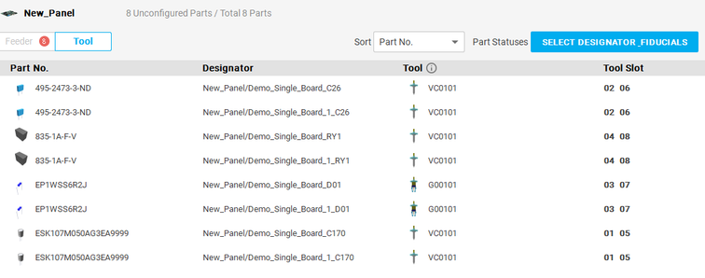
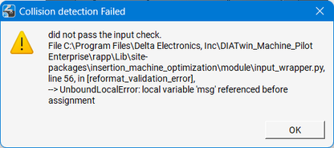
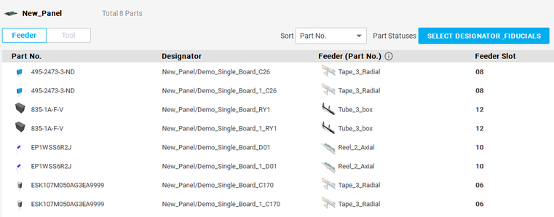
DIATwin MachinePilot Training Kit
Scenario 3 | Panel and Specified Configuration
Save a Traceable Comparison Baseline
Page 15 of 18
Keep Accessory Conditions Consistent
Step 3 of 5
Keep the given feeder/tool configuration. Record any differences in other conditions, such as fiducials.
1
Prepare
2
Panel
Check the error, correct it, and retry.
3
Fixed
Setup
4
Mode
5
Compare
Fig. 3-03c Final setup
Page 67
Notes:
{"使用者母版頁": 45, "原教材頁": 52, "整合單元來源頁": null, "每頁建議分鐘": "3–5", "來源界線": "", "目標": "核對產品、加工範圍與資源，保存可追溯副本，準備相同條件比較。", "未補齊證據": ["S3-GAP-03", "S3-GAP-04"], "截圖處理": "保留真實介面；來源有文字帶者改用既有無文字帶出版截圖；單元局部圖沿用原圖裁切與來源。"}

Slide 16


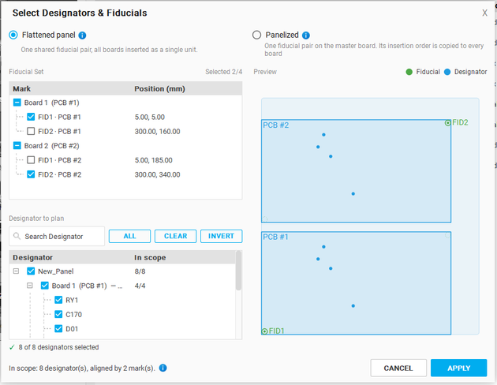
DIATwin MachinePilot Training Kit
Scenario 3 | Panel and Specified Configuration
Open Processing Mode Settings
Page 16 of 18
This case has two boards and eight processing positions. Use the same specified configuration to compare both processing modes.
Step 4 of 5
01
1
Prepare
Select
fiducials (top right).
2
Panel
02
  Flattened Panel
Plan and process the two-board panel as one whole board.
  Panelized
Treat the panel as two separate boards. Plan and process the first board, then process the second in the same way.
3
Fixed
Setup
4
Mode
5
Compare
Page 68
Notes:
{"使用者母版頁": 46, "原教材頁": 53, "整合單元來源頁": 176, "每頁建議分鐘": "3–5", "來源界線": "本次為二連板、共八個加工位置；沿用指定配置，比較兩種加工模式。", "目標": "圖解逐板模式後選用，核對加工位置、光學點及套用範圍。", "未補齊證據": ["S3-GAP-03"], "截圖處理": "保留真實介面；來源有文字帶者改用既有無文字帶出版截圖；單元局部圖沿用原圖裁切與來源。"}

Slide 17
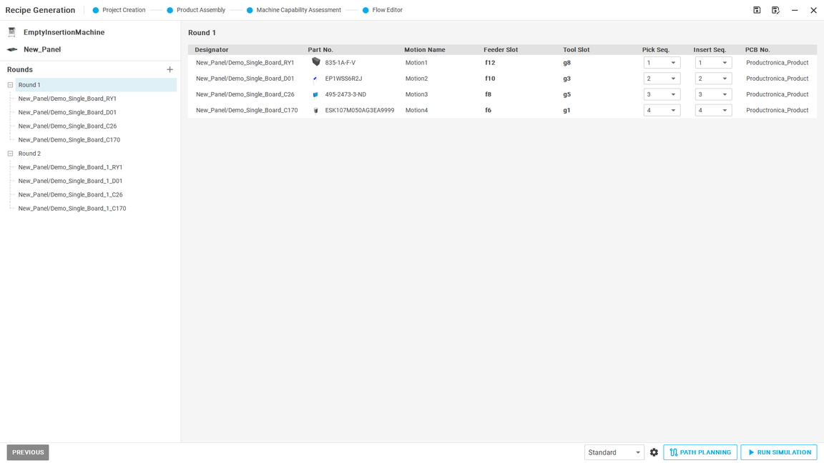
DIATwin MachinePilot Training Kit
Scenario 3 | Panel and Specified Configuration
Flow Editor: Plan Paths Before Simulation
Page 17 of 18
Step 4 of 5
1
Prepare
2
Panel
3
Fixed
Setup
4
Mode
Before RUN SIMULATION,
click PATH PLANNING,
then simulate the planned process.
5
Compare
Page 69
Notes:
{"使用者母版頁": 46, "原教材頁": 53, "整合單元來源頁": 176, "每頁建議分鐘": "3–5", "來源界線": "本次為二連板、共八個加工位置；沿用指定配置，比較兩種加工模式。", "目標": "圖解逐板模式後選用，核對加工位置、光學點及套用範圍。", "未補齊證據": ["S3-GAP-03"], "截圖處理": "保留真實介面；來源有文字帶者改用既有無文字帶出版截圖；單元局部圖沿用原圖裁切與來源。"}

Slide 18
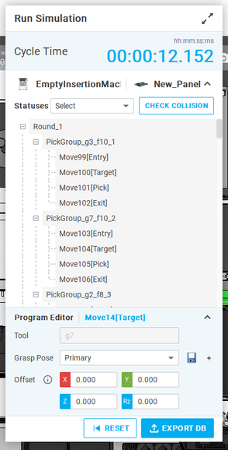
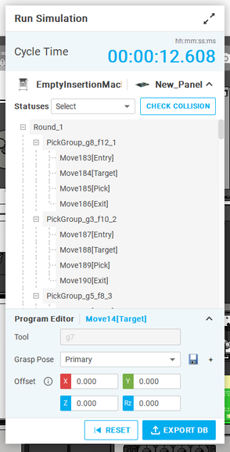
DIATwin MachinePilot Training Kit
Scenario 3 | Panel and Specified Configuration
Compare the Two Processing Modes
Page 18 of 18
Step 5 of 5
Scope Difference
1
Prepare
Panelized plans one board at a time. Flattened Panel includes the entire panel in the plan.
2
Panel
Compare Conditions First
3
Check that the product, eight positions, fiducials, and feeder/tool configuration are the same.
Fixed
Setup
4
Mode
Then Compare Results
Review the actual sequence, completion status, cycle time, and warnings together. Explain when each mode is suitable.
5
Compare
Page 70
Notes:
{"使用者母版頁": 50, "原教材頁": 57, "整合單元來源頁": null, "每頁建議分鐘": "3–5", "來源界線": "", "目標": "用一張並列圖表比較範圍、流程、配置及結果，不預設跨板較快或混用舊四板CT。", "未補齊證據": ["S3-GAP-03", "S3-GAP-04"], "截圖處理": "保留真實介面；來源有文字帶者改用既有無文字帶出版截圖；單元局部圖沿用原圖裁切與來源。"}

