Slide 1

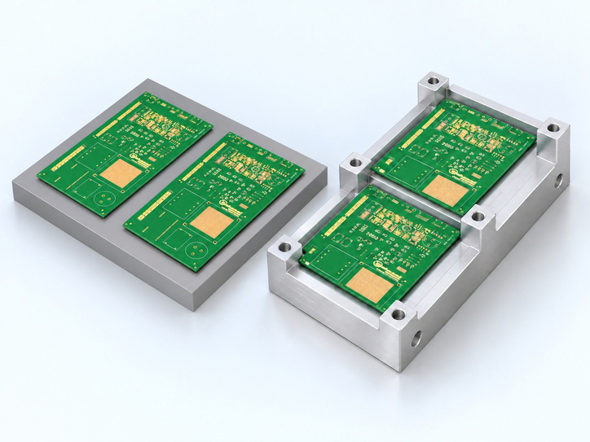
DIATwin MachinePilot Training Kit
Scenario 4 | Carrier and Final Outcome
Scenario 4: Two Products on One Carrier
Page 1 of 18
Step 1 of 5
Shared starting data
1
Prepare
Prepare Demo_Single_Board.
2
No CAD
Without a CAD file
3
Create a simplified carrier from the required geometry and positioning data.
With CAD
4
Plan
With a CAD file
Use pcb_holder.stp and the design reference for a separate example.
5
Results
Page 71
Notes:
{"使用者母版頁": 51, "原教材頁": 58, "整合單元來源頁": null, "每頁建議分鐘": "3–5", "來源界線": "", "目標": "一頁示意兩產品同一載具，列單板／四料表、装載圖及尺寸；有CAD路徑另備STEP及設計結果圖。", "未補齊證據": ["S4-GAP-01"], "截圖處理": "保留真實介面；來源有文字帶者改用既有無文字帶出版截圖；單元局部圖沿用原圖裁切與來源。"}

Slide 2
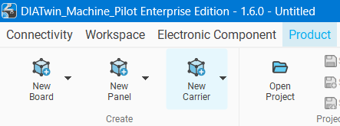
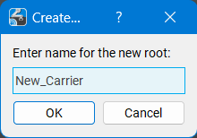
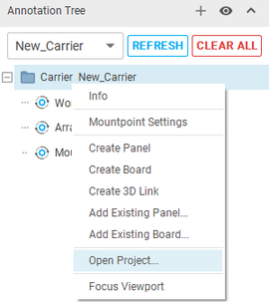
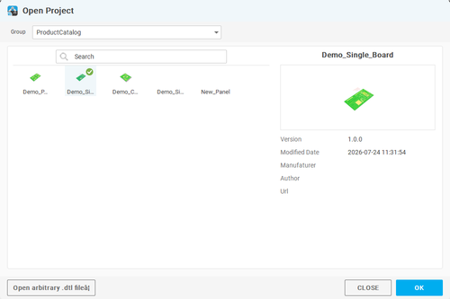
DIATwin MachinePilot Training Kit
Scenario 4 | Carrier and Final Outcome
Create a Carrier
Page 2 of 18
Step 2 of 5
01
1
Prepare
Product → New Carrier. Name the root Carrier; click OK.
2
No CAD
02
Fig. 4-01. Create a carrier
Carrier root → Open Project. Choose Demo_Single_Board from Product Catalog; click OK.
3
With CAD
03
4
Plan
Repeat Open Project to load the same board again. Expand the tree and confirm that Demo_Single_Board and Demo_Single_Board_1 both exist.
5
Results
Fig. 4-02 Load the single board twice
Page 72
Notes:
{"使用者母版頁": 53, "原教材頁": 60, "整合單元來源頁": 162, "每頁建議分鐘": "3–5", "來源界線": "", "目標": "建立Carrier、載入兩個Board並配置第二板位置與方向，同頁依装載圖核對。", "未補齊證據": ["S4-GAP-01", "S4-GAP-02"], "截圖處理": "保留真實介面；來源有文字帶者改用既有無文字帶出版截圖；單元局部圖沿用原圖裁切與來源。"}

Slide 3
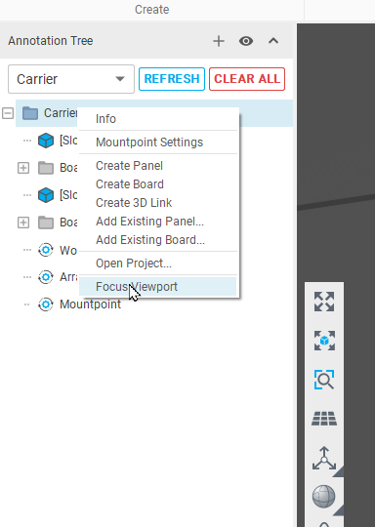
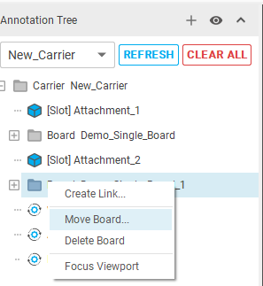
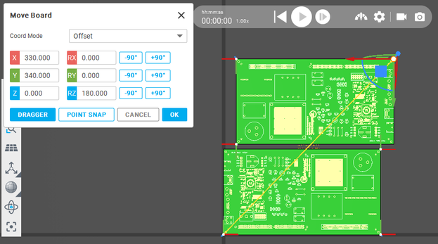
DIATwin MachinePilot Training Kit
Scenario 4 | Carrier and Final Outcome
Focus on the Objects
Page 3 of 18
Step 2 of 5
01
1
Prepare
Carrier root → Focus Viewport.
02
2
No CAD
Right-click Demo_Single_Board_1 → Move Board. Select Offset coordinates. Set X=330, Y=340, Z=0 mm, RX=0, RY=0, and RZ=180°. Click OK.
Fig. 4-03. Focus on the objects
3
With CAD
4
Plan
5
Results
Page 73
Fig. 4-04 Second board position
Notes:
{"使用者母版頁": 53, "原教材頁": 60, "整合單元來源頁": 163, "每頁建議分鐘": "3–5", "來源界線": "", "目標": "建立Carrier、載入兩個Board並配置第二板位置與方向，同頁依装載圖核對。", "未補齊證據": ["S4-GAP-01", "S4-GAP-02"], "截圖處理": "保留真實介面；來源有文字帶者改用既有無文字帶出版截圖；單元局部圖沿用原圖裁切與來源。"}

Slide 4
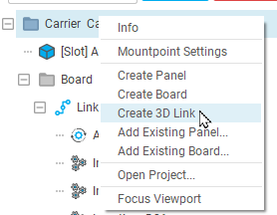
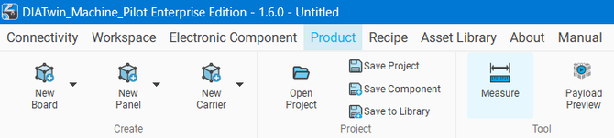
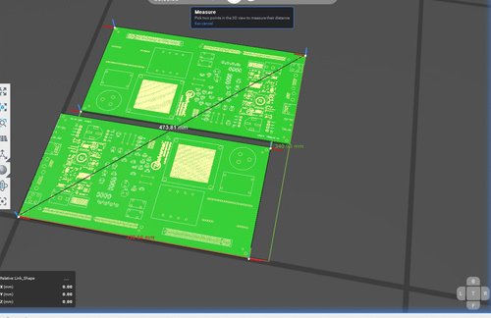
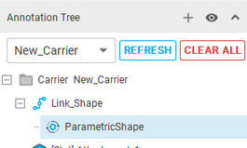
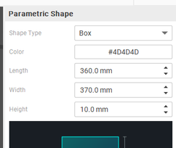
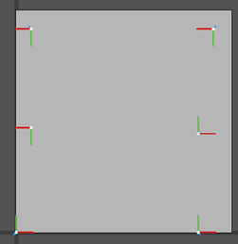
DIATwin MachinePilot Training Kit
Scenario 4 | Carrier and Final Outcome
Create the Concept Geometry
Page 4 of 18
Step 2 of 5
01
1
Prepare
Carrier root → Create 3D Link. Select Parametric Shape and Box.
2
No CAD
02
Measure the layout's lower-left and upper-right corners; exit Measure.
3
With CAD
Fig. 4-05 Concept geometry
Fig. 4-06 Measure boards
4
Plan
03
Set color #4D4D4D; length 360, width 370, height 10 mm. Click Generate.
5
Results
Note
Exit Measure: after the reference points and line appear, press Esc.
Page 74
Fig. 4-07 Carrier box
Notes:
{"使用者母版頁": 54, "原教材頁": 61, "整合單元來源頁": 164, "每頁建議分鐘": "3–5", "來源界線": "", "目標": "量測範圍後建立概念Box，量測圖、尺寸設定與外形結果同頁。", "未補齊證據": ["S4-GAP-01"], "截圖處理": "保留真實介面；來源有文字帶者改用既有無文字帶出版截圖；單元局部圖沿用原圖裁切與來源。"}

Slide 5
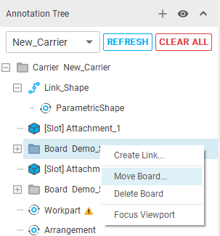
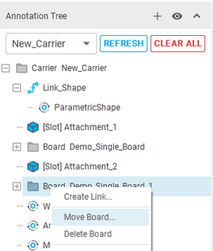
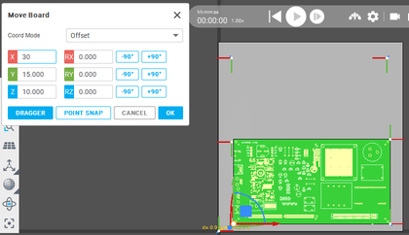
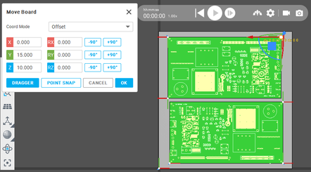
DIATwin MachinePilot Training Kit
Scenario 4 | Carrier and Final Outcome
Position the Two Boards
Page 5 of 18
Step 2 of 5
01
1
Prepare
Board1,X = 30,Y = 15,Z = 10
2
No CAD
02
Board2,X = 0.0,Y = 15,Z = 10
3
With CAD
Fig. 4-08. Adjust both board heights
4
Plan
5
Results
Page 75
Fig. 4-09 Board offsets
Notes:
{"使用者母版頁": 55, "原教材頁": 62, "整合單元來源頁": 165, "每頁建議分鐘": "3–5", "來源界線": "", "目標": "用側視圖說明板件高度與載具位置，示範後確認相對關係，避免座標模式混用。", "未補齊證據": ["S4-GAP-01"], "截圖處理": "保留真實介面；來源有文字帶者改用既有無文字帶出版截圖；單元局部圖沿用原圖裁切與來源。"}

Slide 6
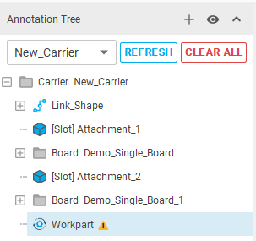
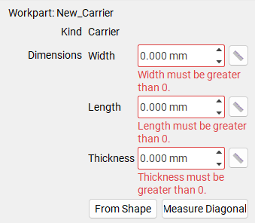
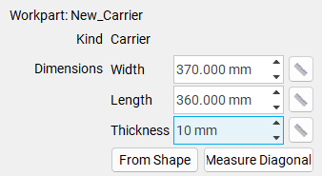
DIATwin MachinePilot Training Kit
Scenario 4 | Carrier and Final Outcome
Set Workpart Dimensions Without CAD
Page 6 of 18
Step 2 of 5
01
1
Prepare
Select the carrier's Workpart properties and click Measure Diagonal. Select a lower corner and the diagonally opposite upper corner.
See the earlier chapter for details.
Alternatively, enter:
Width 370
Length 360
Thickness 10 mm
2
No CAD
3
With CAD
4
Plan
5
Results
Fig. 4-10 Workpart dimensions
Page 76
Notes:
{"使用者母版頁": 56, "原教材頁": 63, "整合單元來源頁": 166, "每頁建議分鐘": "3–5", "來源界線": "", "目標": "確認整體Workpart與預設定位點，不延伸Set Seat；列為優先試講頁。", "未補齊證據": ["S4-GAP-01"], "截圖處理": "保留真實介面；來源有文字帶者改用既有無文字帶出版截圖；單元局部圖沿用原圖裁切與來源。"}

Slide 7
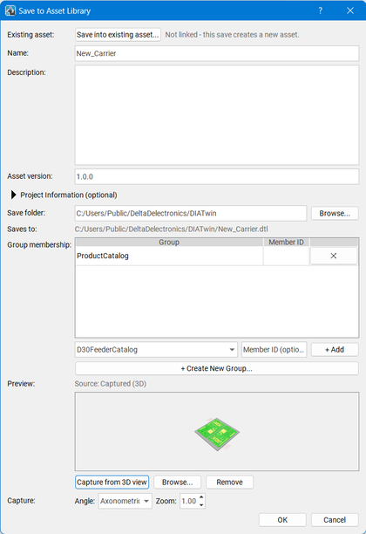
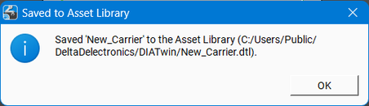
DIATwin MachinePilot Training Kit
Scenario 4 | Carrier and Final Outcome
Save the Carrier
Page 7 of 18
Step 2 of 5
01
1
Prepare
Save: check name/path/catalog. Capture from 3D View; OK. Confirm success.
2
No CAD
02
Recipe → Create Project: find the saved carrier in Product.
3
With CAD
4
Plan
5
Results
Fig. 4-11 Save carrier
Page 77
Notes:
{"使用者母版頁": 57, "原教材頁": 64, "整合單元來源頁": 167, "每頁建議分鐘": "3–5", "來源界線": "", "目標": "保存預覽與資產，核對兩板、外形、位置及高度，概念Box不是可製造性驗證。", "未補齊證據": ["S4-GAP-02"], "截圖處理": "保留真實介面；來源有文字帶者改用既有無文字帶出版截圖；單元局部圖沿用原圖裁切與來源。"}

Slide 8
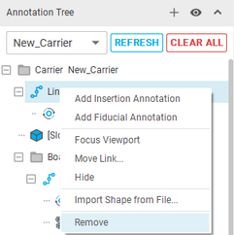
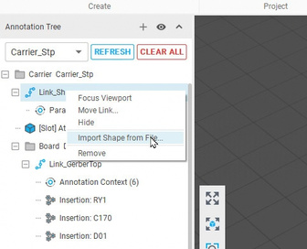
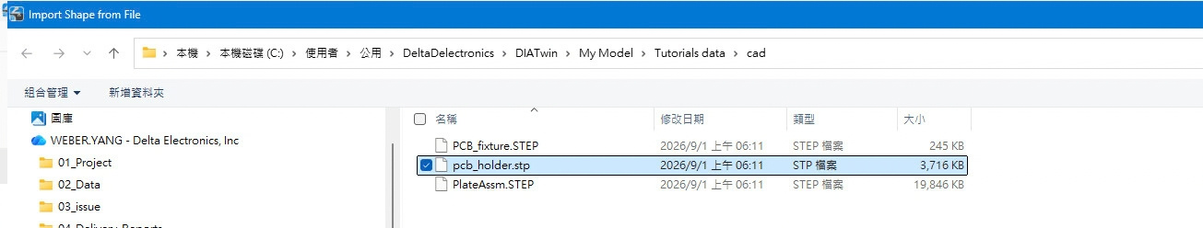
DIATwin MachinePilot Training Kit
Scenario 4 | Carrier and Final Outcome
Import STEP Geometry
Page 8 of 18
The STEP carrier and the box carrier without CAD are separate examples with different dimensions. Check each independently.
Step 3 of 5
01
1
Prepare
Carrier geometry link → Import Shape from File.
02 Select the tutorial file
2
No CAD
02
Open Tutorials data/cad/pcb_holder.stp. Check the carrier geometry.
3
With CAD
Fig. 4-12a Remove geometry
Fig. 4-12b Import STEP
03
4
Plan
Select Hide Floor on the display toolbar at the left of the 3D rendering view.
5
Results
Fig. 4-12c Select STEP file
Page 78
Notes:
{"使用者母版頁": 58, "原教材頁": 65, "整合單元來源頁": 168, "每頁建議分鐘": "3–5", "來源界線": "有圖檔案例採用 STEP 載具；其尺寸與無圖檔方塊案例不同，分別核對。", "目標": "獨立建立Carrier與Board，匯入pcb_holder.stp並確認外形，不繼承Box高度或位移。", "未補齊證據": ["S4-GAP-01"], "截圖處理": "保留真實介面；來源有文字帶者改用既有無文字帶出版截圖；單元局部圖沿用原圖裁切與來源。"}

Slide 9
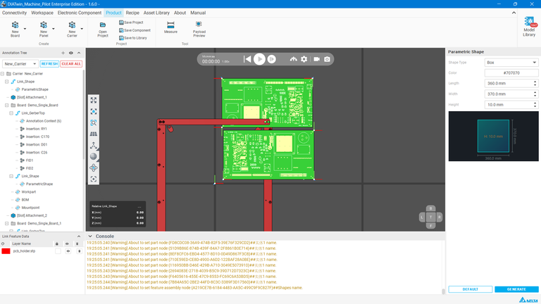

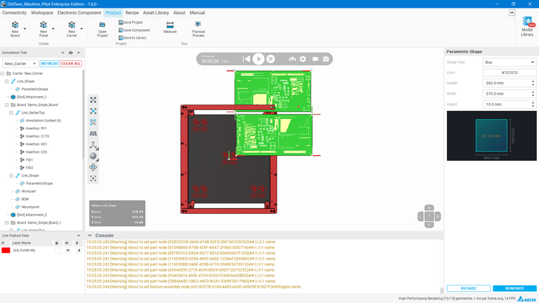
DIATwin MachinePilot Training Kit
Scenario 4 | Carrier and Final Outcome
Show and Hide the Floor
Page 9 of 18
The STEP carrier and the box carrier without CAD are separate examples with different dimensions. Check each independently.
Step 3 of 5
01
1
Prepare
Carrier geometry link → Import Shape from File.
2
No CAD
02
Open Tutorials data/cad/pcb_holder.stp. Check the carrier geometry.
3
With CAD
Fig. 4-13a. Before hiding
03
4
Plan
Select Hide Floor on the display toolbar at the left of the 3D rendering view.
5
Results
Fig. 4-13. Hide the floor
Page 79
Fig. 4-13b Floor hidden
Notes:
{"使用者母版頁": 58, "原教材頁": 65, "整合單元來源頁": 168, "每頁建議分鐘": "3–5", "來源界線": "有圖檔案例採用 STEP 載具；其尺寸與無圖檔方塊案例不同，分別核對。", "目標": "獨立建立Carrier與Board，匯入pcb_holder.stp並確認外形，不繼承Box高度或位移。", "未補齊證據": ["S4-GAP-01"], "截圖處理": "保留真實介面；來源有文字帶者改用既有無文字帶出版截圖；單元局部圖沿用原圖裁切與來源。"}

Slide 10
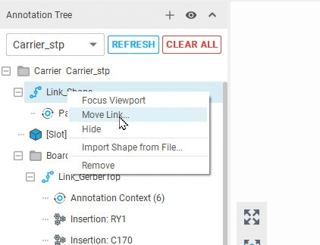
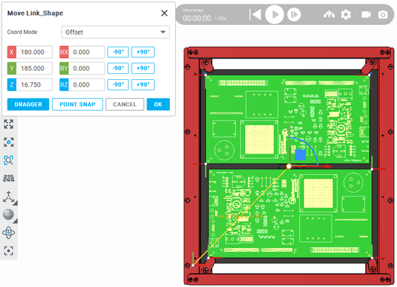
DIATwin MachinePilot Training Kit
Scenario 4 | Carrier and Final Outcome
Move the Carrier Geometry
Page 10 of 18
The STEP carrier and the box carrier without CAD are separate examples with different dimensions. Check each independently.
Step 3 of 5
01
1
Prepare
Geometry link → Move Geometry Link → Offset.
2
No CAD
02
Set X=180.0, Y=185.0, Z=16.75 mm. Keep RX, RY, and RZ at 0 and click OK.
3
With CAD
4
Plan
5
Results
Fig. 4-14a Move Geometry Link
Fig. 4-14b. Set the carrier position
Page 80
Notes:
{"使用者母版頁": 59, "原教材頁": 66, "整合單元來源頁": 169, "每頁建議分鐘": "3–5", "來源界線": "有圖檔案例採用 STEP 載具；其尺寸與無圖檔方塊案例不同，分別核對。", "目標": "對照CAD及裝載要求，設定載具與板件位置、方向及高度，代表動作後核對整體。", "未補齊證據": ["S4-GAP-01"], "截圖處理": "保留真實介面；來源有文字帶者改用既有無文字帶出版截圖；單元局部圖沿用原圖裁切與來源。"}

Slide 11
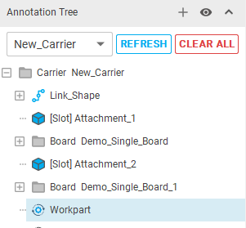
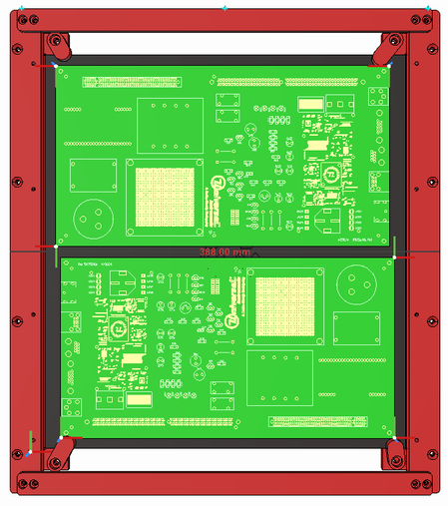
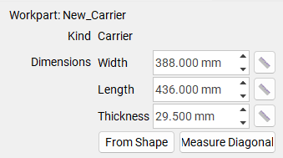
DIATwin MachinePilot Training Kit
Scenario 4 | Carrier and Final Outcome
Set Workpart Dimensions With CAD
Page 11 of 18
The carriers with and without CAD are separate examples. Check their dimensions and positioning conditions independently.
Step 3 of 5
01
1
Prepare
Select Workpart at the carrier level. Confirm that the Properties panel refers to the current carrier.
2
No CAD
3
With CAD
02
Measure Diagonal: select opposite lower/upper corners. Check width 388, length 436, thickness 29.5 mm; enter thickness if needed.
4
Plan
5
Results
Page 81
Fig. 4-15 Workpart dimensions
Notes:
{"使用者母版頁": 60, "原教材頁": 67, "整合單元來源頁": 170, "每頁建議分鐘": "3–5", "來源界線": "有圖檔案例採用 STEP 載具；其尺寸與無圖檔方塊案例不同，分別核對。", "目標": "量測整體尺寸後建立預設定位點，用同一模型圖確認厚度、位置Z與定位關係。", "未補齊證據": ["S4-GAP-01"], "截圖處理": "保留真實介面；來源有文字帶者改用既有無文字帶出版截圖；單元局部圖沿用原圖裁切與來源。"}

Slide 12
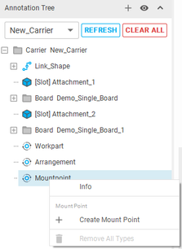
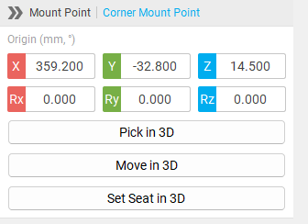
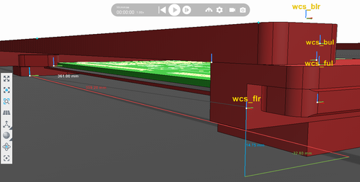
DIATwin MachinePilot Training Kit
Scenario 4 | Carrier and Final Outcome
Create the CAD Carrier's Attachment Point
Page 12 of 18
Step 3 of 5
01
1
Prepare
Right-click the carrier's attachment-point node and select Create Attachment Point.
2
No CAD
3
With CAD
02
Measure from the origin: click empty floor, then the carrier's machine contact point.
wcs_flr is the origin.
X=359.2, Y=−32.8, Z=14.5.
Enter these values as shown above.
4
Plan
5
Results
Fig. 4-16 Attachment point
Page 82
Notes:
{"使用者母版頁": 60, "原教材頁": 67, "整合單元來源頁": 170, "每頁建議分鐘": "3–5", "來源界線": "有圖檔案例採用 STEP 載具；其尺寸與無圖檔方塊案例不同，分別核對。", "目標": "量測整體尺寸後建立預設定位點，用同一模型圖確認厚度、位置Z與定位關係。", "未補齊證據": ["S4-GAP-01"], "截圖處理": "保留真實介面；來源有文字帶者改用既有無文字帶出版截圖；單元局部圖沿用原圖裁切與來源。"}

Slide 13
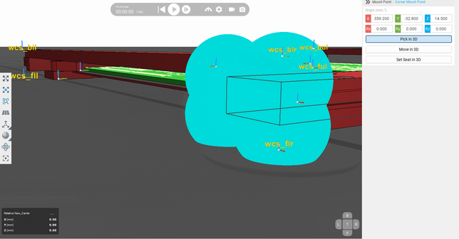
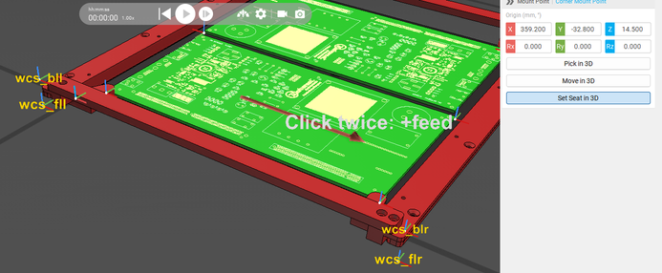
DIATwin MachinePilot Training Kit
Scenario 4 | Carrier and Final Outcome
CAD Carrier Attachment Point (Continued)
Page 13 of 18
Step 3 of 5
Pick in 3D / Set Seat in 3D are not yet fully supported; verify the attachment point.
1
Prepare
2
No CAD
3
With CAD
4
Plan
5
Results
Fig. 4-16a Pick in 3D
Fig. 4-16b Set seat in 3D
Page 83
Notes:
{"使用者母版頁": 60, "原教材頁": 67, "整合單元來源頁": 170, "每頁建議分鐘": "3–5", "來源界線": "有圖檔案例採用 STEP 載具；其尺寸與無圖檔方塊案例不同，分別核對。", "目標": "量測整體尺寸後建立預設定位點，用同一模型圖確認厚度、位置Z與定位關係。", "未補齊證據": ["S4-GAP-01"], "截圖處理": "保留真實介面；來源有文字帶者改用既有無文字帶出版截圖；單元局部圖沿用原圖裁切與來源。"}

Slide 14
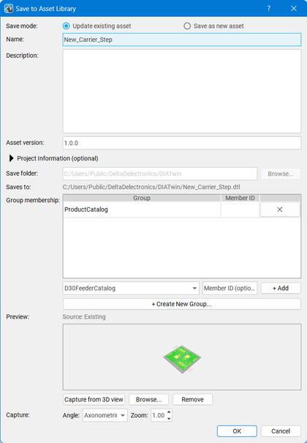
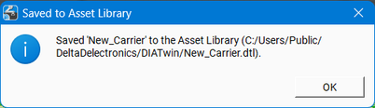
DIATwin MachinePilot Training Kit
Scenario 4 | Carrier and Final Outcome
Set the Save Information
Page 14 of 18
The STEP carrier and the box carrier without CAD are separate examples with different dimensions. Check each independently.
Step 3 of 5
01
1
Prepare
Save New_Carrier_Step: check path/catalog; Capture from 3D View, then OK.
2
No CAD
02
3
With CAD
Check the saved name in the success message. Click OK.
4
Plan
03
Select Recipe → Project Creation → Create Project. Find New_Carrier_Step or your chosen name in the Product list.
5
Results
Fig. 4-17 Save STEP carrier
Page 84
Notes:
{"使用者母版頁": 61, "原教材頁": 68, "整合單元來源頁": 171, "每頁建議分鐘": "3–5", "來源界線": "有圖檔案例採用 STEP 載具；其尺寸與無圖檔方塊案例不同，分別核對。", "目標": "保存名稱、型錄與預覽，核對成功訊息及本案身分。", "未補齊證據": ["S4-GAP-02"], "截圖處理": "保留真實介面；來源有文字帶者改用既有無文字帶出版截圖；單元局部圖沿用原圖裁切與來源。"}

Slide 15
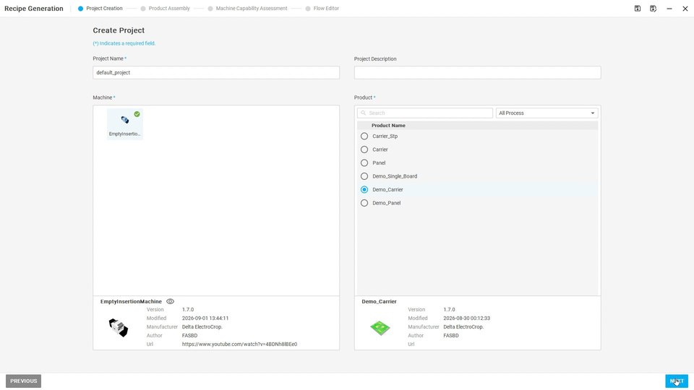
DIATwin MachinePilot Training Kit
Scenario 4 | Carrier and Final Outcome
Continue from Carrier Product to Recipe
Page 15 of 18
Step 4 of 5
Select the product
1
Prepare
Find the concept or STEP carrier by its saved name.
2
No CAD
Processing data
3
Check the four processing locations on each board and the required positioning references.
With CAD
4
Plan
Machine requirements
Check assembly conditions and supported feeders and tools. Learners plan the recipe independently.
5
Results
Page 85
Notes:
{"使用者母版頁": 63, "原教材頁": 70, "整合單元來源頁": null, "每頁建議分鐘": "3–5", "來源界線": "", "目標": "確認載具可選取，核對加工位置、機台與配件依賴，完成產品自檢；不重教完整Recipe。", "未補齊證據": ["S4-GAP-02", "S4-EXT-01"], "截圖處理": "保留真實介面；來源有文字帶者改用既有無文字帶出版截圖；單元局部圖沿用原圖裁切與來源。"}

Slide 16
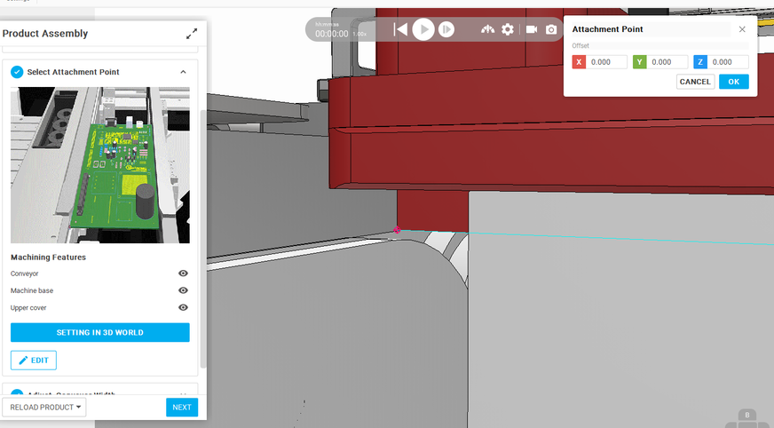
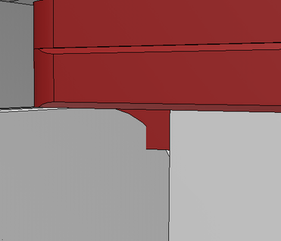
DIATwin MachinePilot Training Kit
Scenario 4 | Carrier and Final Outcome
Final Exercise: Select the Attachment Point
Page 16 of 18
Step 4 of 5
Incorrect fit; point hidden
1
Prepare
Step 3:
SETTING IN 3D WORLD.
Pick points to align with the conveyor.
2
No CAD
3
With CAD
4
Plan
5
Results
Page 86
Notes:
{"使用者母版頁": 64, "原教材頁": 71, "整合單元來源頁": null, "每頁建議分鐘": "3–5", "來源界線": "", "目標": "一頁任務卡與三策略圖：全自動、指定配件／槽位、限制區域後自動，學員擇一完成。", "未補齊證據": ["S4-EXT-01"], "截圖處理": "保留真實介面；來源有文字帶者改用既有無文字帶出版截圖；單元局部圖沿用原圖裁切與來源。"}

Slide 17
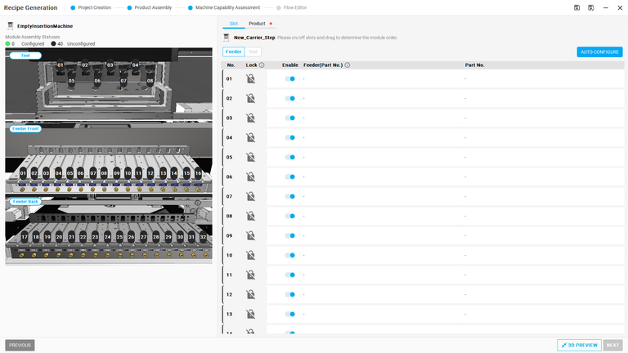
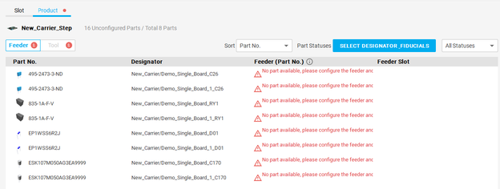
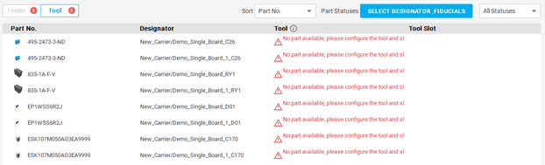
DIATwin MachinePilot Training Kit
Scenario 4 | Carrier and Final Outcome
Final Exercise: Choose a Configuration Strategy
Page 17 of 18
Step 4 of 5
A: Fully automatic planning
1
Prepare
Let the system select supported accessories and available positions.
2
No CAD
B: Specify accessories and slots
3
Specify compatible modules and supported slots, then plan the process.
With CAD
4
Plan
C: Auto-configure within an area
Lock unavailable empty slots and let the algorithm use the permitted area. Complete one strategy with your own carrier.
5
Results
Page 87
Notes:
{"使用者母版頁": 64, "原教材頁": 71, "整合單元來源頁": null, "每頁建議分鐘": "3–5", "來源界線": "", "目標": "一頁任務卡與三策略圖：全自動、指定配件／槽位、限制區域後自動，學員擇一完成。", "未補齊證據": ["S4-EXT-01"], "截圖處理": "保留真實介面；來源有文字帶者改用既有無文字帶出版截圖；單元局部圖沿用原圖裁切與來源。"}

Slide 18
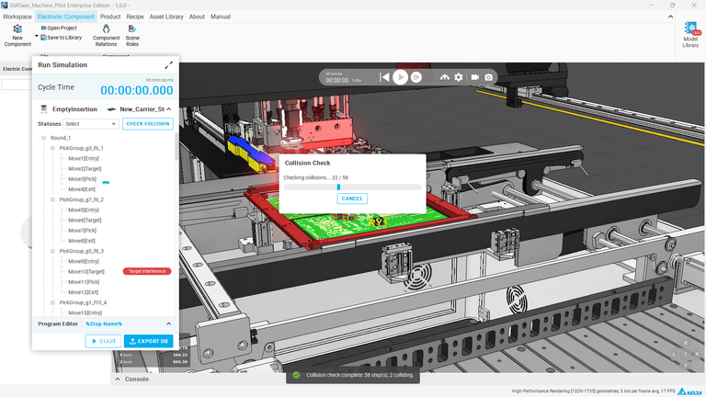
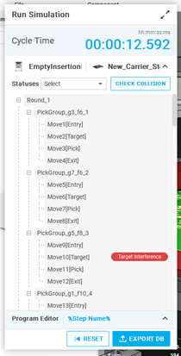
DIATwin MachinePilot Training Kit
Scenario 4 | Carrier and Final Outcome
Run the Simulation and Explain the Results
Page 18 of 18
Step 5 of 5
Check interference first
1
Prepare
Record the collision status and conditions that need attention.
2
No CAD
Run the recipe
3
Simulate with the same product and configuration. Observe progress and completion.
With CAD
4
Plan
Obtain different cycle-time results
Record the available cycle time, warnings, and unfinished items.
5
Results
Page 88
Notes:
{"使用者母版頁": 66, "原教材頁": 73, "整合單元來源頁": null, "每頁建議分鐘": "3–5", "來源界線": "", "目標": "說明實作需執行與記錄的模擬、警告、CT及實際狀態；完整運算與作業另排。", "未補齊證據": ["S4-EXT-01", "G-CHECK"], "截圖處理": "保留真實介面；來源有文字帶者改用既有無文字帶出版截圖；單元局部圖沿用原圖裁切與來源。"}

